Slide 1
fMRI Task
Effect of self-relevance in health volunteers
Participant is presented with one word at a time and instructed to press 1 if the presented word applies to them or 2 if it does not.
Examples of stimuli words:
Positive: clear-headed, discreet, well-mannered, productive
Negative: disagreeable, grouchy, reckless, lazy
Neutral/ambiguous: unemotional, soft-hearted, wordy, meditative, ordinary
mfBA10
Moran JM, Macrae CN, Heatherton TF, Wyland CL, Kelley WM. Neuroanatomical evidence for distinct cognitive and affective components of self. J Cogn Neurosci 2006; 18(9): 1586-94.

Slide 2
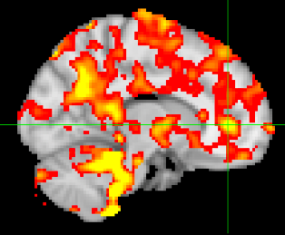
Feasibility at IUSM
BOLD valence-related activation during Trait-Adjective task for volunteer Jon at IUSM; note expected signal peak at mfBA10, our TMS target (crosshairs).

Slide 3
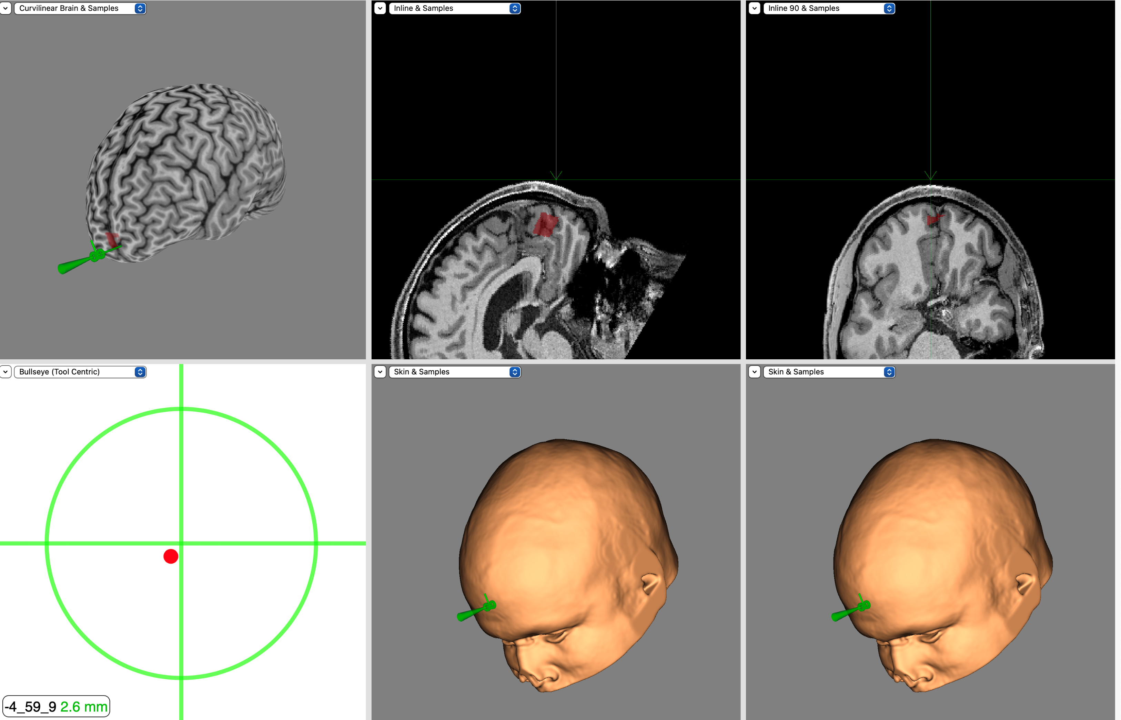
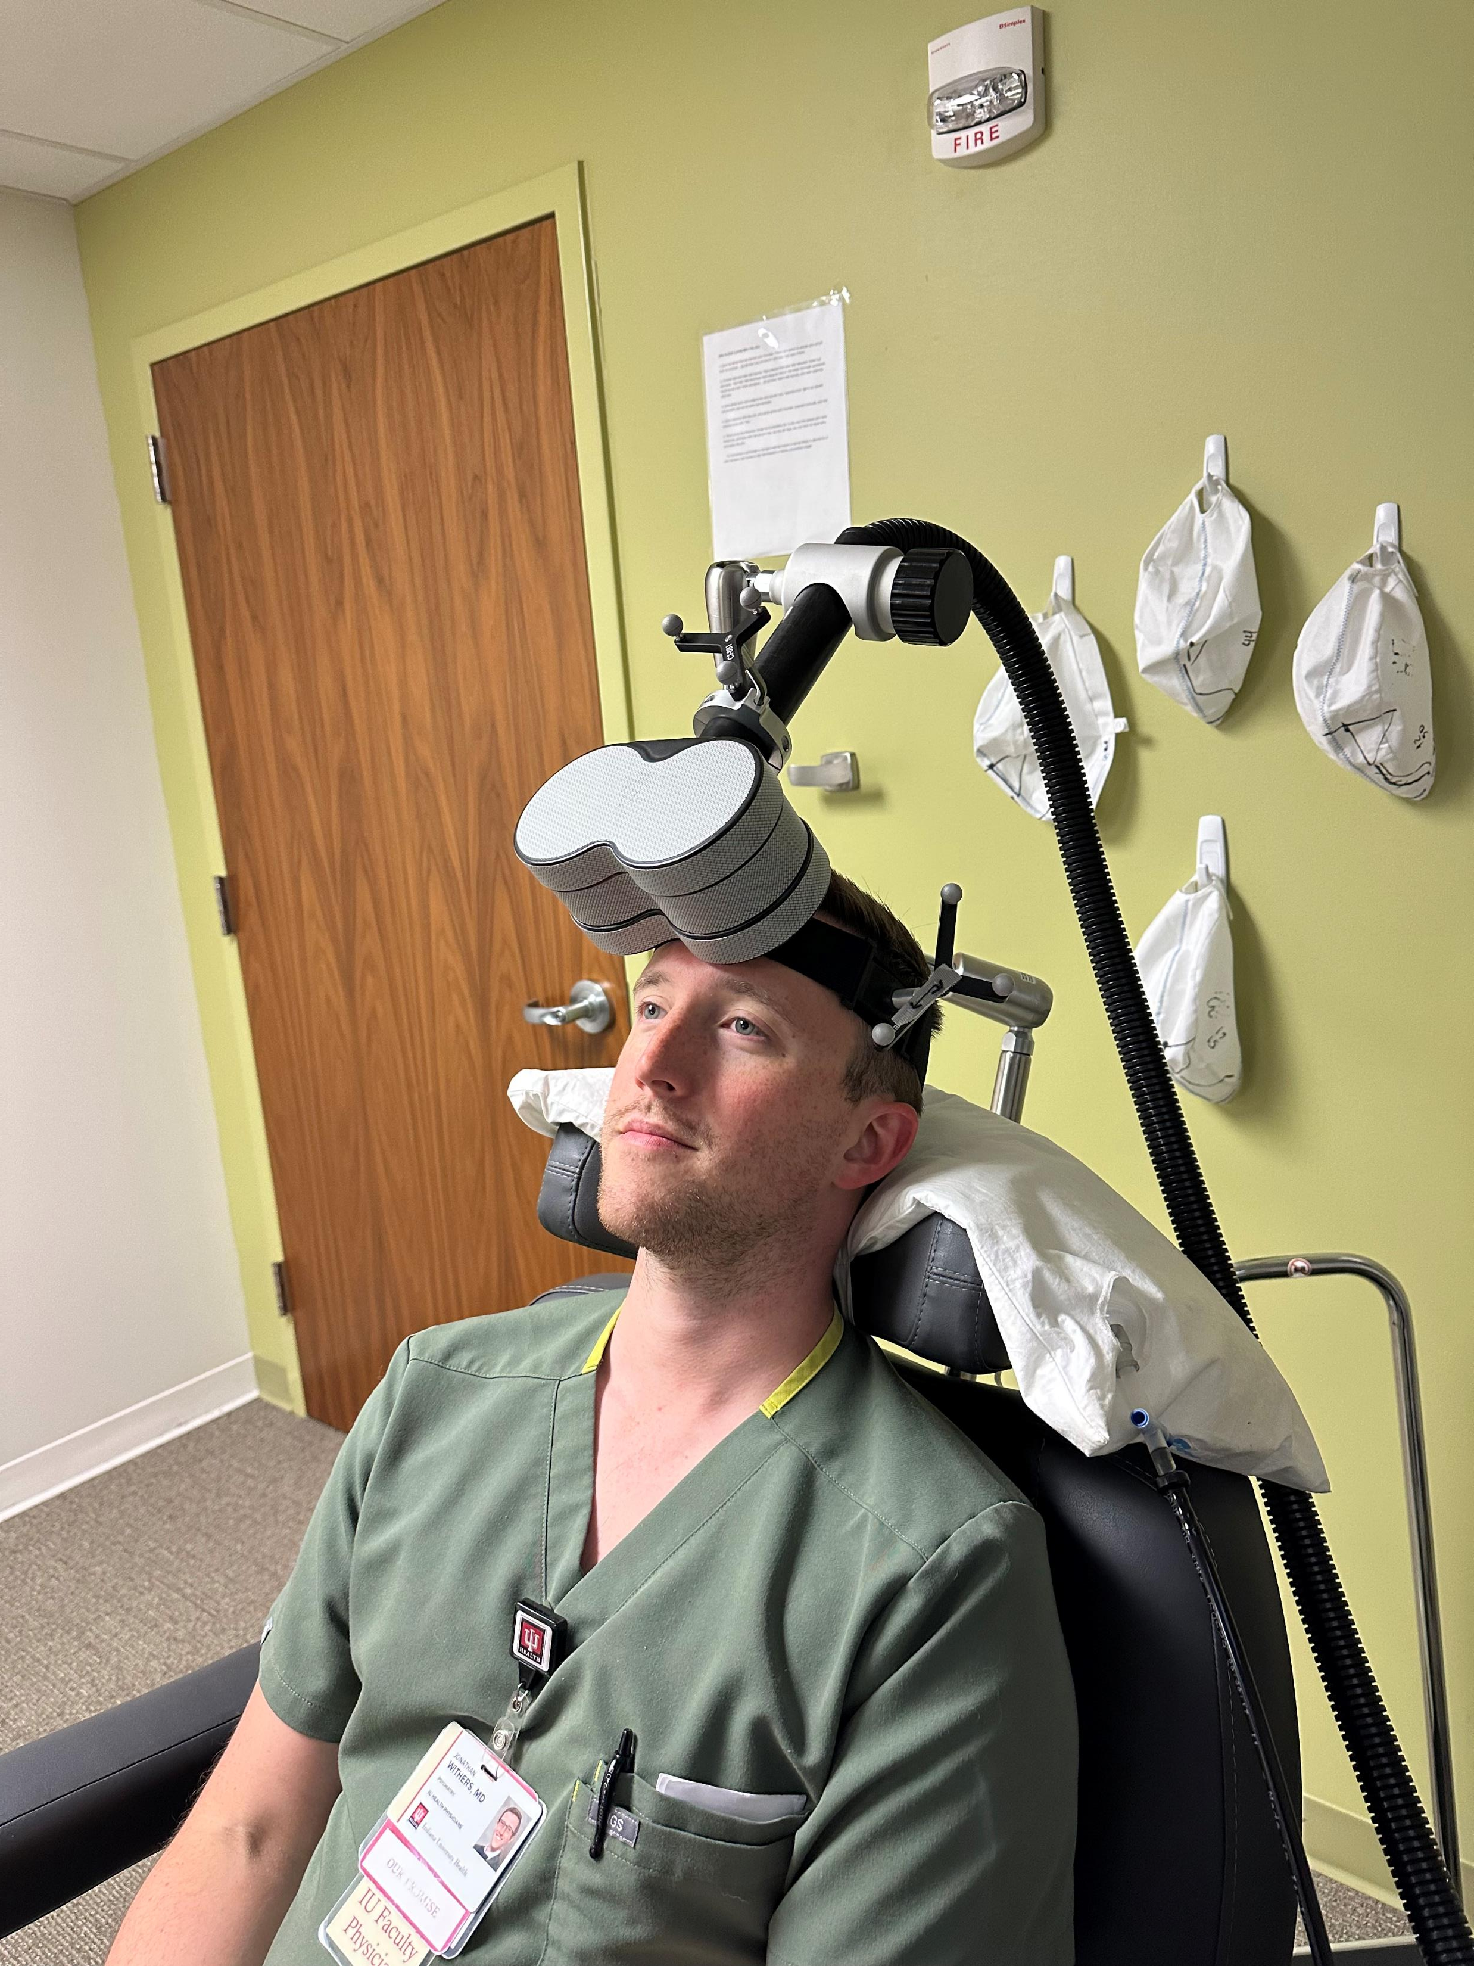
Image-guided Targeting
mfBA10 in Jon’s brain
Spheres attached to coil and Jon’s head to track relative position in 3-D with infrared camera. Skull landmarks (tip of nose, ears) were used to establish spatial relationship between Jon and his MRI
Bullseye indicates real-time 3-D position of coil relative to Jon is on-target

