Slide 1
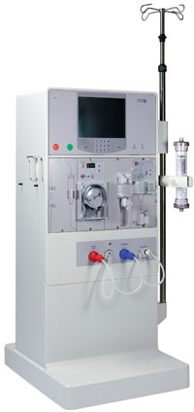
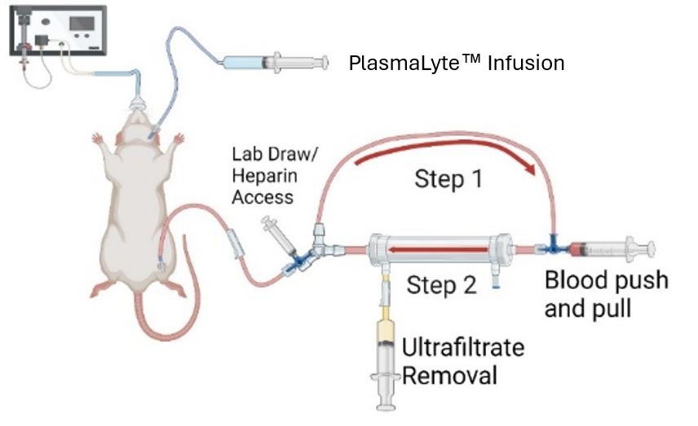
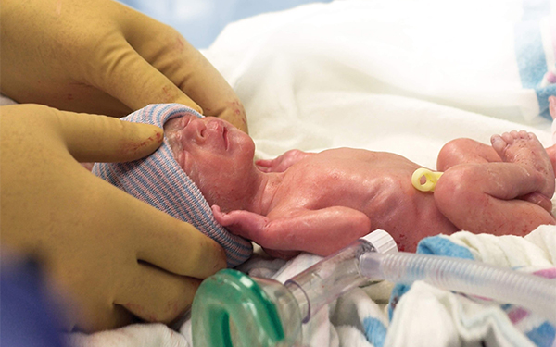
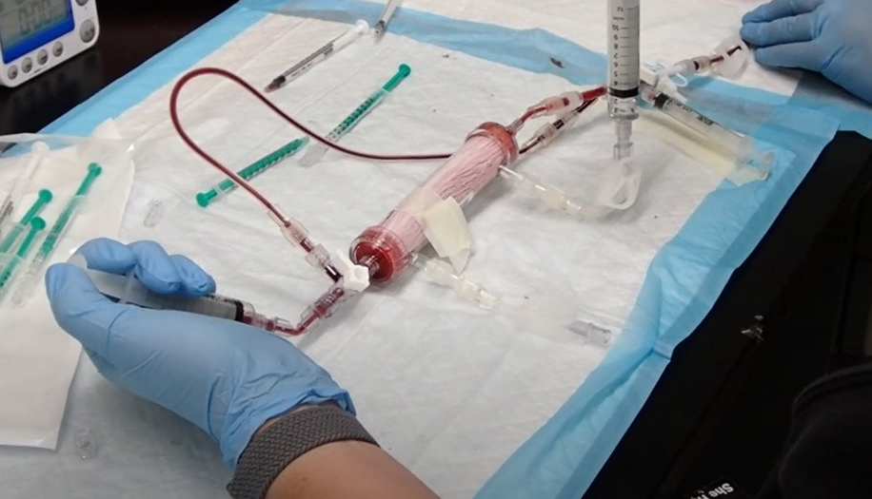
Miniaturized Manual Renal Replacement Therapy: Pre-clinical Model for Neonatal Applications
^{a,b}Carl Russell III, ªAngus Stergar, ^{c}Giovanni Ceschia, ªRose Odom, ^{a,d}Michelle C. Starr, ^{e}Jolyn Morgan, ^{e}Amanda Snyder , ^{f}Denise Hasson, ^{g}Ed Pulte, ^{h}Apaara K Chawla, ^{c,i}Stuart Goldstein, ^{a,b,d}Danielle E. Soranno, ^{a,d}Cara L. Slagle
Extremely Low Birth Weight Patients
Unable to maintain fluid homeostasis
Current Hemodialysis Options
The Brophy Kit
500 ml of blood in circuit | 32 ml of blood in circuit | < 32 ml of blood in circuit
Adults | Patients weighing 2.5-10kg | Patients weighing <2.5 kg
Vermont Oxford Network
Peritoneal Dialysis is Limited
Decreased skin integrity
Unreliable ultrafiltration
ªIndiana University School of Medicine, Department of Pediatrics, Indianapolis, IN, USA;
^{b}Purdue University Weldon School of Biomedical Engineering, West Lafayette, IN, USA;
^{c}Cincinnati Children’s Hospital and Indiana University Health, Cincinnati, OH, USA;
^{d}Riley Hospital for Children, Indianapolis, IN, USA;
^{e}Cincinnati Children’s Hospital, Cincinnati, OH, USA;
^{f}New York University Langone Health, New York, NY, USA;
^{g}ExThera Medical Inc, Martinez, CA ;
^{h}George Washington University, Washington, DC, USA;
^{i}University of Cincinnati College of Medicine, Department of Pediatrics, Cincinnati, OH, USA

Slide 2
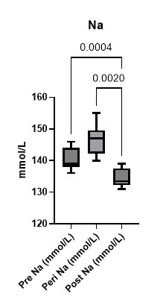
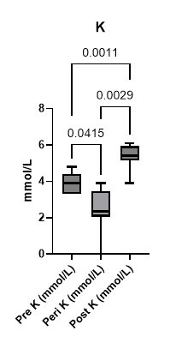
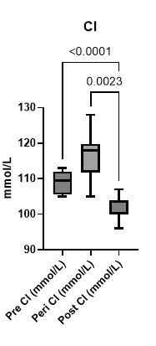
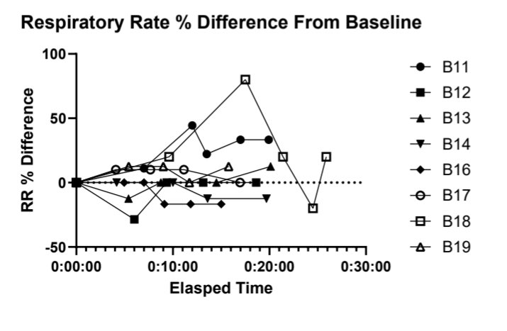
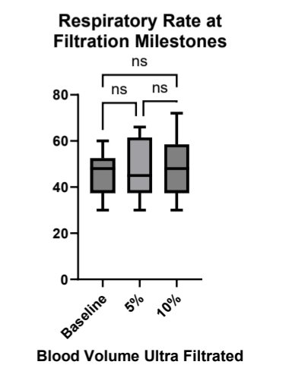
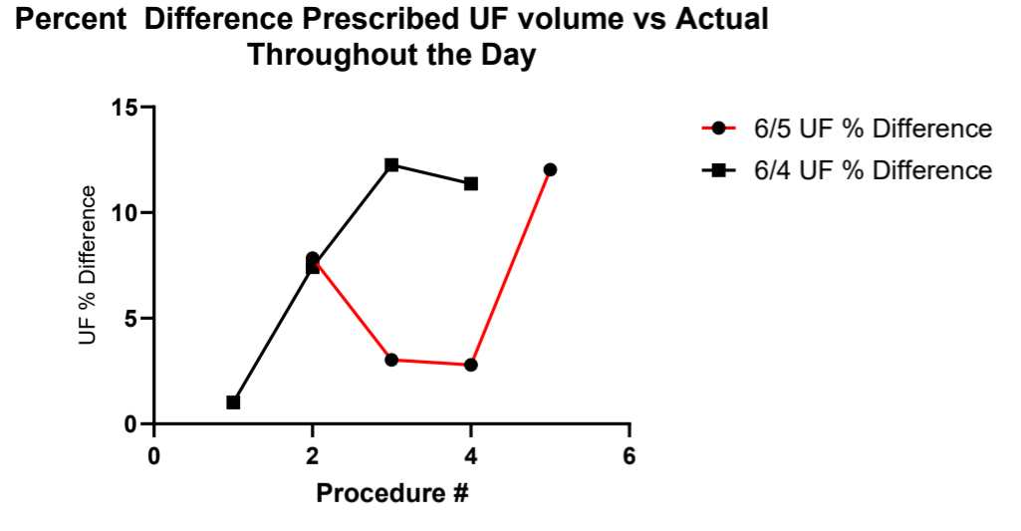
Miniaturized Manual Renal Replacement Therapy: Pre-clinical Model for Neonatal Applications
^{a,b}Carl Russell III, ªAngus Stergar, ^{c}Giovanni Ceschia, ªRose Odom, ^{a,d}Michelle C. Starr, ^{e}Jolyn Morgan, ^{e}Amanda Snyder , ^{f}Denise Hasson, ^{g}Ed Pulte, ^{h}Apaara K Chawla, ^{c,i}Stuart Goldstein, ^{a,b,d}Danielle E. Soranno, ^{a,d}Cara L. Slagle
The Experiment Demonstrated the Following
Stable Respiratory Rates
Serum Equilibration to PlasmaLyte™ Infusion
Quantifiable Operator Fatigue
Percent Difference Prescribed Ultrafiltration Volume vs Actual Throughout the Day
Post Procedure Serum to PlasmaLyte™
% Difference: Na {4.1%}; K {5.15%}, Cl {0.25%}
ªIndiana University School of Medicine, Department of Pediatrics, Indianapolis, IN, USA;
^{b}Purdue University Weldon School of Biomedical Engineering, West Lafayette, IN, USA;
^{c}Cincinnati Children’s Hospital and Indiana University Health, Cincinnati, OH, USA;
^{d}Riley Hospital for Children, Indianapolis, IN, USA;
^{e}Cincinnati Children’s Hospital, Cincinnati, OH, USA;
^{f}New York University Langone Health, New York, NY, USA;
^{g}ExThera Medical Inc, Martinez, CA ;
^{h}George Washington University, Washington, DC, USA;
^{i}University of Cincinnati College of Medicine, Department of Pediatrics, Cincinnati, OH, USA

Slide 3
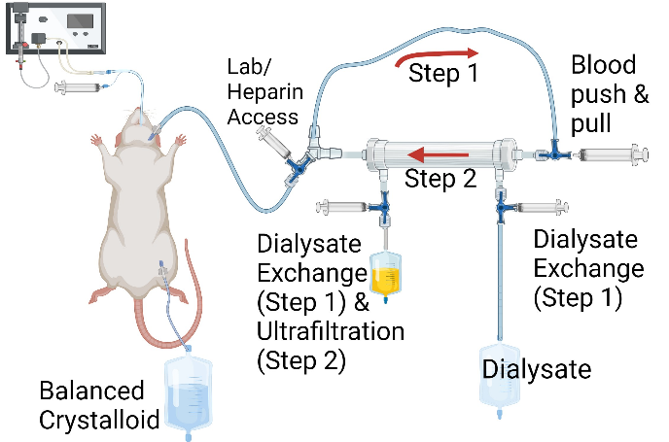
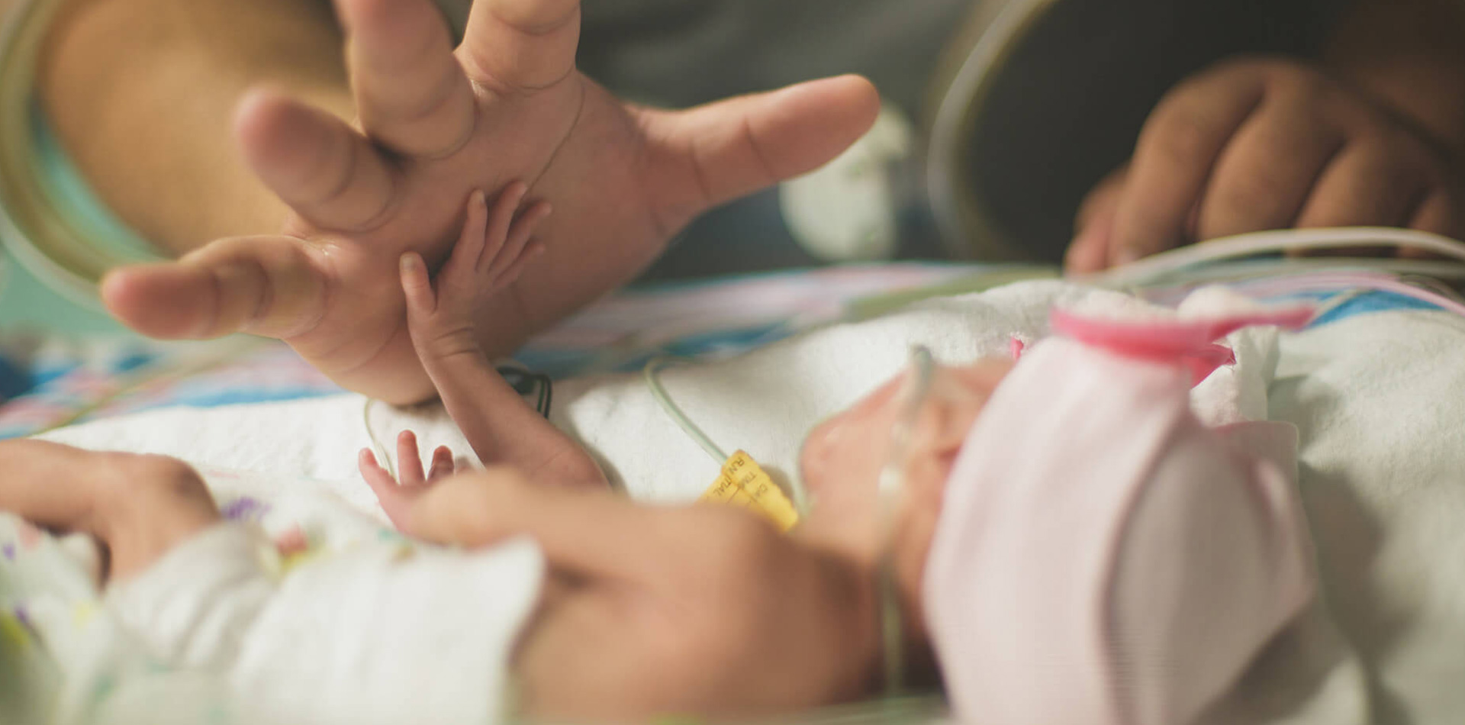
Miniaturized Manual Renal Replacement Therapy: Pre-clinical Model for Neonatal Applications
^{a,b}Carl Russell III, ªAngus Stergar, ^{c}Giovanni Ceschia, ªRose Odom, ^{a,d}Michelle C. Starr, ^{e}Jolyn Morgan, ^{e}Amanda Snyder , ^{f}Denise Hasson, ^{g}Ed Pulte, ^{h}Apaara K Chawla, ^{c,i}Stuart Goldstein, ^{a,b,d}Danielle E. Soranno, ^{a,d}Cara L. Slagle
Key Takeaways From Use on Healthy Rodents
Next Steps
Translational Impact
Improve the Care of Our Extremely Low Birth Weight Patients
Stable Respiratory Rates
Serum Equilibration to PlasmaLyte™ Infusion
Dialyze on a Disease Model
Quantifiable Operator Fatigue
- Use 2 operators instead of 1
https://www.icubaby.org/
Bring to market via humanitarian device exemption
ªIndiana University School of Medicine, Department of Pediatrics, Indianapolis, IN, USA;
^{b}Purdue University Weldon School of Biomedical Engineering, West Lafayette, IN, USA;
^{c}Cincinnati Children’s Hospital and Indiana University Health, Cincinnati, OH, USA;
^{d}Riley Hospital for Children, Indianapolis, IN, USA;
^{e}Cincinnati Children’s Hospital, Cincinnati, OH, USA;
^{f}New York University Langone Health, New York, NY, USA;
^{g}ExThera Medical Inc, Martinez, CA ;
^{h}George Washington University, Washington, DC, USA;
^{i}University of Cincinnati College of Medicine, Department of Pediatrics, Cincinnati, OH, USA

