Slide 1
Applications of Machine Learning in Tissue Image Analysis - Autoencoder
Input
Decoder
Output
Copy an input to an output.
Encoder compresses input image into a low-dimensional space.
Decoder attempts to reconstruct the image.
Anomalous images detected based off of the reconstruction error.
High reconstruction error can indicate that an image is anomalous.
Encoder
Latent space representation
Sequential Model
Image Preprocessing (resizing)
Encoder (layers decrease dimension of output)
Decoder (layers increase dimension of output)
Results
Ineffective for our lab’s use
Reconstructed tissue images did not contain the necessary level of detail to be used for meaningful analysis.
The complexity of the H&E images and the limited training data likely contributed to this limitation.
Set threshold for images to be considered “anomalous”.
Find reconstruction error for images.
Plot and save reconstructed images

Slide 2
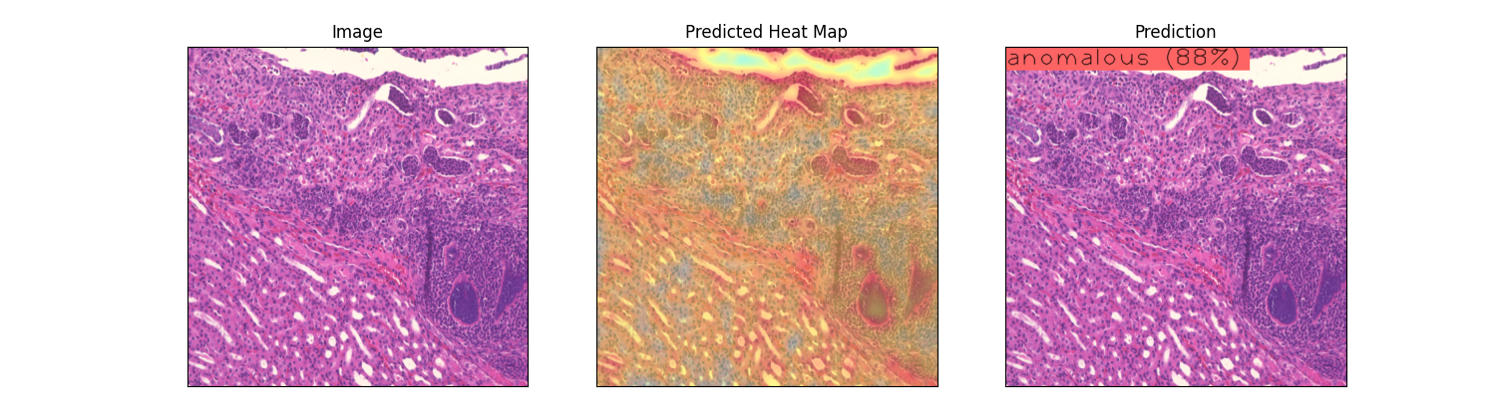
Applications of Machine Learning in Tissue Image Analysis - Anomalib
Library.
State-of-the-art visual anomaly detection and localization algorithms.
Generates heatmaps highlighting anomalies in images.
Python class that contains methods to process data.
Create datamodule to handle custom dataset
Split images into training, testing, validation sets.
Create Reverse Distillation model11
Results
Showed moderate success in identifying features of the kidney tissue.
Generated heatmaps did not provide any valuable insights.
Test Model. Results (generated heatmaps and predicted classification) automatically saved.
Instantiate Engine
and train model (training set to stop 1 epoch after no improvement)

Slide 3
Histomorphological Phenotype Learning (HPL)
As this is a new framework, adapting the program to fit our needs poses significant challenges and technical issues – both with HPL and other necessary frameworks. Despite this, HPL’s approach of clustering tiles for feature discovery holds promise for future research in histopathology.
Framework.
Completely unsupervised methodology .
Groups tissue images by similarity.
Goal of identifying distinct features in the tissue.
Has been applied to cancer tissue with promising results.
Store in h5 files (one for training, testing, and validation)
Tile whole slide images
Sort images into training, testing, validation.
Cluster tile vector representations (leiden clustering).
Create vector representations for each tile.
Train self-supervised model (Barlow Twins).
a list of numbers that captures information about each tile’s features
Outputs are clustering configuration files as well as cluster assignments for each tile.

