Slide 1

Indiana Clinical and Translational Sciences Institute
2023 Annual Meeting
Unraveling Retinal Phenotypic Changes in a Hyperglycemic Late-Onset Alzheimer's Disease Mouse Model
Abhyankar, Surabhi D.^{1,2}, Luo, Qianyi2, Hartman, Gabriella D.^{2,3}, Corson, Timothy W.^{1,2,3,4}, Oblak, Adrian L.^{3,4}, Lamb, Bruce T.^{3,4}, Bhatwadekar, Ashay^{1,2,4}
¹Indiana University, Department of Biochemistry and Molecular Biology, Indianapolis, Indiana; ²Department of Ophthalmology, Eugene and Marilyn Glick Eye Institute, Indianapolis, Indiana; ³Stark Neurosciences Research Institute, Indianapolis, Indiana; ⁴Department of Pharmacology & Toxicology, Indianapolis, Indiana

Slide 2
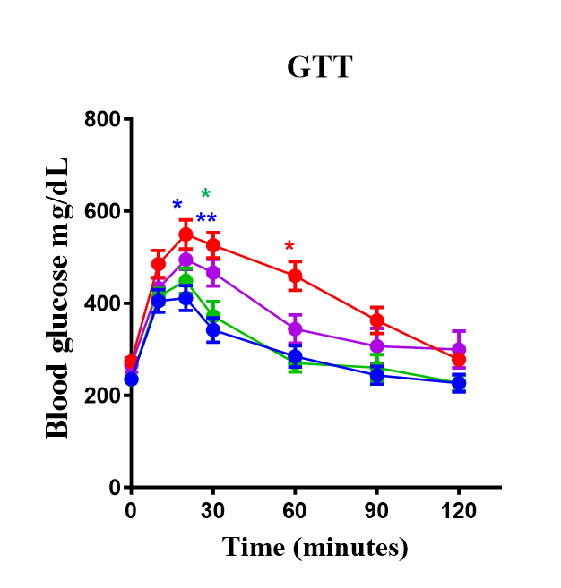
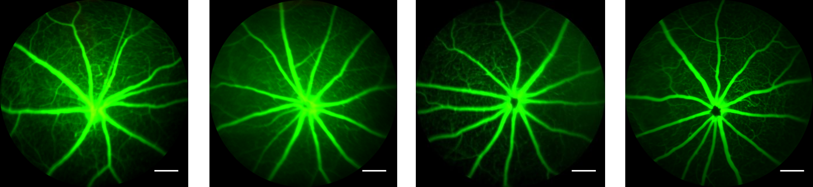
Here’s what we found
Late Onset Alzheimer’s Disease (LOAD) and diabetes may interact to exacerbate retinal dysfunction and promote the onset and progression of diabetic retinopathy.
Glucose metabolism was impaired in western diet fed LOAD-risk mice.
Our study demonstrates that retinal thickness,
vascular changes
and retinal
functional deficits
are the earliest indicators of damage in the retina of LOAD-risk mice.
Glucose metabolism
Retinal thickness
Retinal vasculature
Retinal function
APOE3 CD | APOE3 WD | APOE4 CD | APOE4 WD
Unpublished data
Notes:
Begin by stating the Super Big Results (state them in 3 key points, like an outline)

Slide 3
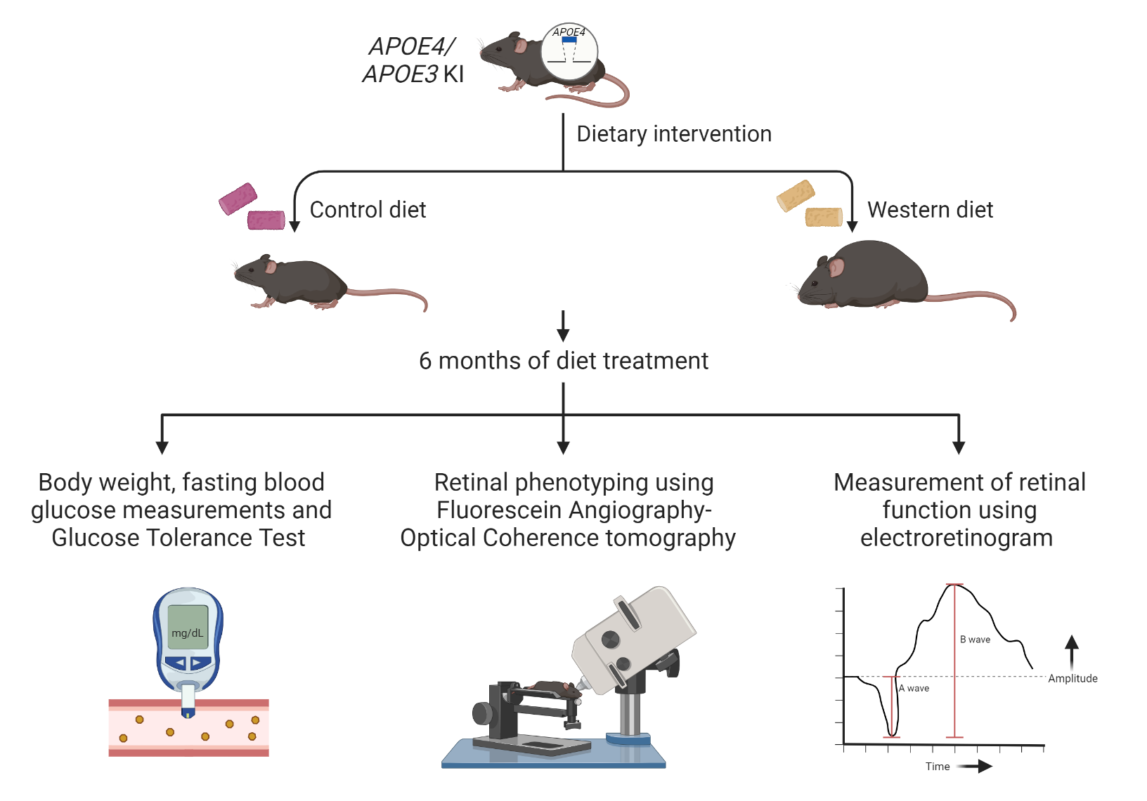
Here’s how we did it
Mouse models:
Apolipoprotein E4 (APOE4): Genetic risk factor for Late Onset Alzheimer’s Disease.
Apolipoprotein E3 (APOE3): Neutral for Alzheimer’s Disease.
Cartoon created with Biorender_Surabhi D. Abhyankar

Slide 4
Future implications for patients or the community/ or next steps
Patients with Alzheimer’s Disease exhibit an association between Diabetic Retinopathy. Our research clarifies the connection between these two ailments.
These discoveries shed light on the mechanisms behind retinal dysfunction in a mouse model with a heightened risk of LOAD combined with diabetes.
This will help us to identify novel non-invasive biomarkers for diagnosing and monitoring Alzheimer’s Disease progression.
Notes:
Before creating your 3 slides that will form your 2-minute video, think about how you would present your slides in a TWEET, and use that brief format to guide your points. Provide key takeaways for the most impact.

Slide 5
Grant Acknowledgement
This work is supported by: NIH- NEI R01: R01EY027779, R01EY027779-S1 and R01EY032080 and Research to Prevent Blindness. The content is solely the responsibility of the authors and does not necessarily represent the official views of the National Institutes of Health or the funding entities.
Notes:
If your project or training has been supported by the Indiana CTSI, your poster and PowerPoint presentation should include acknowledgement of the appropriate Indiana CTSI grant.
For your convenience, we have added this list of award sources to the last slide of the PowerPoint template. Please review the list of award sources and delete those that did not contribute to the conduct of the research reported in your presentation.
If your project or training was supported by other grants, please remember to acknowledge those grants as well.

