Slide 1

Indiana Clinical and Translational Sciences Institute
2023 Annual Meeting
3D printed guided bone regeneration (GBR) graft optimized through finite element analysis (FEA)
Claudia Benito Alston, Nicanor Moldovan, Clark Barco, Luis Solorio
Notes:
3D printed guided bone regeneration (GBR) graft optimized through finite element analysis (FEA)

Slide 2
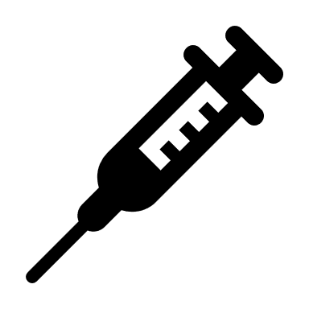


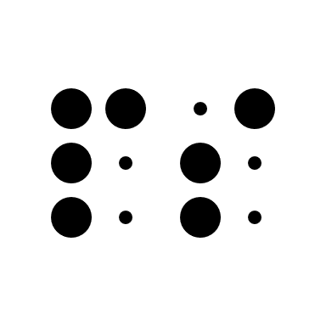
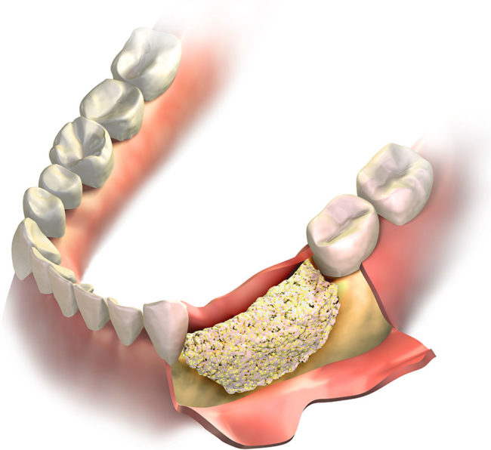
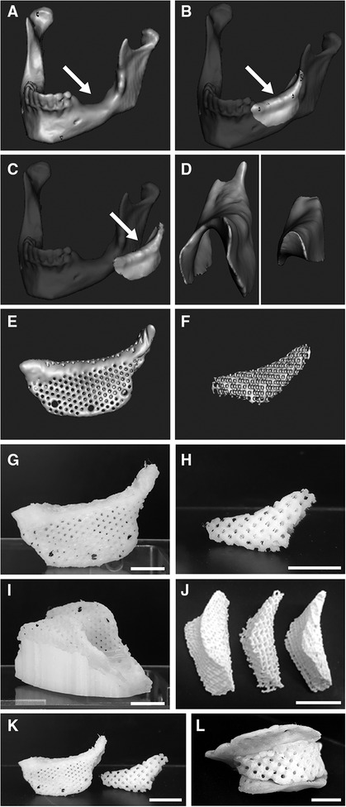
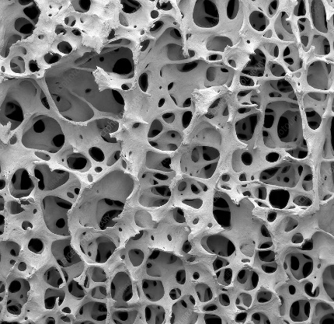
Example slide:
These findings, discovered by researchers at Indiana University School of Medicine, have implications for clinical studies around the world, beyond just triple negative breast cancer
Disseminated as an oral plenary session as part of the prestigious San Antonio Breast Cancer Symposium and the prestigious peer-reviewed international journal, JAMA Oncology, are testaments to the credibility of these scientific findings
These discoveries form the basis of an upcoming Phase II clinical study named PERSEVERE which will stratify patients based on their risk of recurrence and help find targeted therapies for this high risk group.
Benefits of a 3D Printed Design
Shorter surgery
Reproducible porosity
Protective cover with limited stress shielding
Entirely resorbable and integrated graft
Current standard of care
Implications for patients
Current standard of care
Benefits of a 3D Printed Design
Shorter surgery
Reproducible porosity
Protective cover with limited stress shielding
Entirely resorbable and integrated graft
Cover
Core
Hydrogel Core
Trabecular Bone SEM¹
1. https://www.sciencephoto.com/media/879096/view/bone-tissue-sem
Notes:
Critical size defect maxillofacial reconstruction can be necessary for a myriad of reasons, the simplest being tooth loss leading to bone loss. The current standard of care makes use of bone particulate *click* that are packed in a defect, then covered with a titanium mesh *click* and fixed in place with titanium screws. This leads to unreproducible packing or porosities. The benefits of a 3D printed bone grafts are: a shorter surgery (which is important due to ORs costing around 70$ per minute), *click* reproducible pre-designed porosities to allow for maximum cell infiltration, *click* the ability to separately print a protective cover to limit stress shielding, *click* lastly all the materials being resorbable and fully integratable. We designed a cover and core concept to improve osteointegration by modeling a 3D printed core with a protective cover.

Slide 3


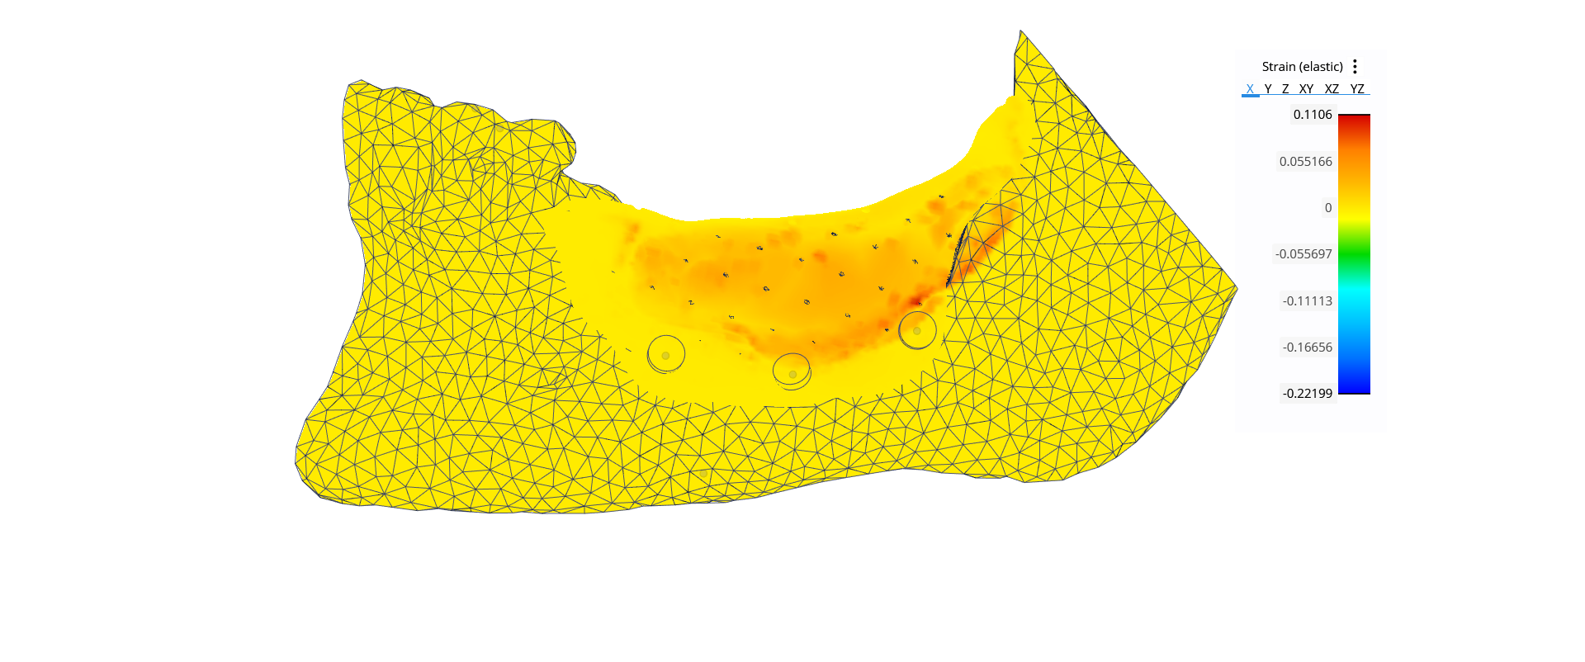
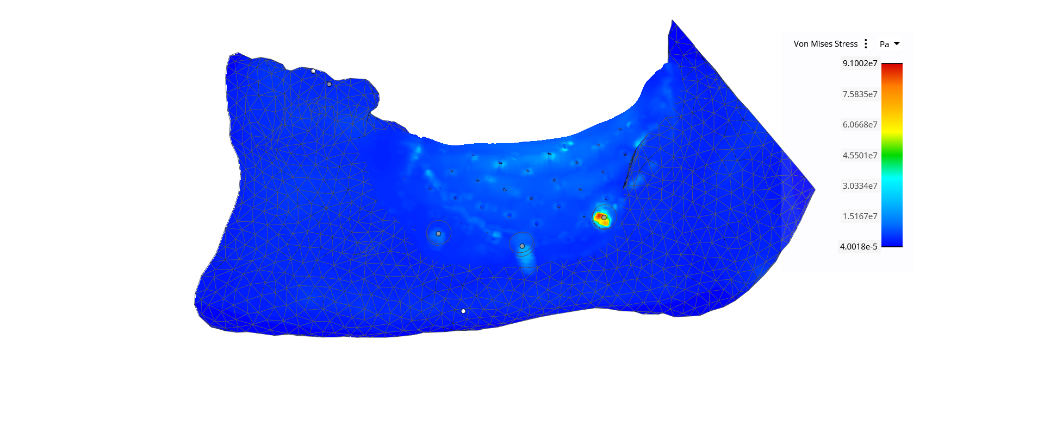
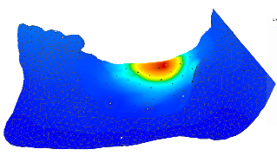

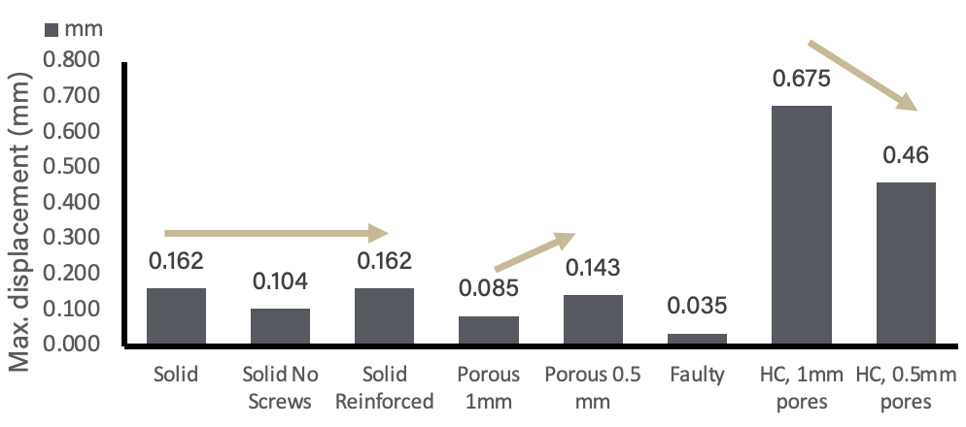
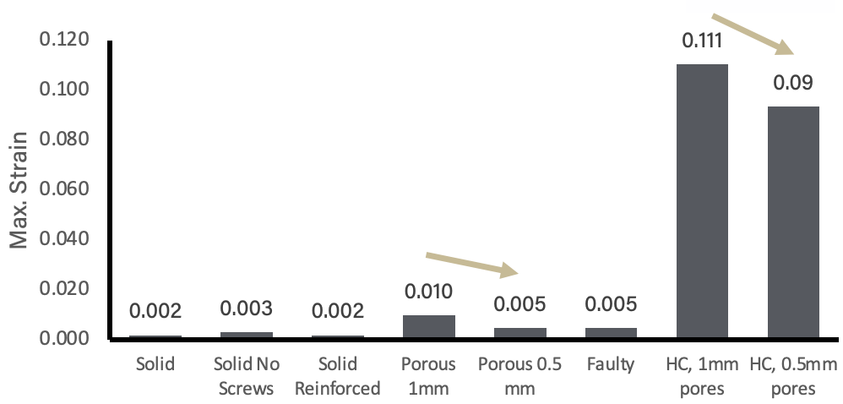
A porous cover sustains mastication while limiting stress shielding
Pore sizes didn’t affect the solid core VMS.
The porous models displayed the second highest non-screw values at ~5 MPa at the PCL cover with TCP cores, compared to ~30 MPa hydrogel core
Example slide:
We discovered – for the first time ever – that there’s now a scientific way to determine which women will relapse following surgery and chemotherapy for triple negative breast and which will remain disease free for up to at least two years
This discovery stops the fear of the unknown that women with triple negative breast cancer having been living in, by providing them a scientific way to determine whether or not their disease is coming back
These findings are so significant they are now being used in clinical studies beyond triple negative breast cancer, to now include colon and other breast cancer studies.
The 0.5mm porous cover lowered the overall strain, for both the solid and hydrogel core.
Adding screws to the cover increased the VMS value, most likely due to forces propagating down to the screws. Although, all the maximum values are beneath
The 0.5mm porous cover experienced the highest strain, almost doubling the solid model
Legend
Teeth only | T
Solid | S
Solid No Screws | SNS
Solid Reinforced | SR
Porous 1mm | 1P
Porous 0.5 mm | 0.5P
Small pores Displacement~= No pores Displacement
Larger Pore Displacement > No Pores Displacement
Calcium Core = Too Stiff
Hydrogel Core = Too Flexible although tunable
The PCL cover wouldn’t yield under a masticatory load
Tensile Yield Strength of PCL = 2505 MPa
0.5 mm Pore Strain = ~2X Solid Cover Strain
Ideal Range
Screws and a small porosity had a minimal effect on displacement. A larger porosity had a larger effect on displacement.
*No standard deviations due to deterministic nature of model
Stiffening the hydrogel core should begin to fall within the ideal range
Notes:
We demonstrated that a porous cover-core design with a hydrogel core and simply buccal screws would achieve the goal of sustaining mastication without yielding while providing the least stress shielding and allowing diffusion of biological factors through pores. *click* We created 6 different models to assess the cover and screws: mastication only on the Teeth, mastication along the entire ridge on a Solid cover with buccal screws, a Solid cover with No Screws, a Solid Reinforced cover with added lingual screws, and both a 1mm and 0.5mm Porous Cover models. *click* The Von Mises Stress demonstrated that none of the materials would yield since all the values found were below the yield strengths of the materials themselves. *click* The highest strain was at the 0.5mm porous cover, almost 2x higher than the solid cover. *click* The displacement was found to increase when the porosity had 1mm pores. *click* Lastly, the difference between the solid core and hydrogel core can be seen throughout these graphs although the hydrogel core is higher than the desired ideal range, it can be modulated to be stiffer, therefore bringing the translated stress into the range.
Begin by stating the Super Big Results (state them in 3 key points, like an outline)

Slide 4
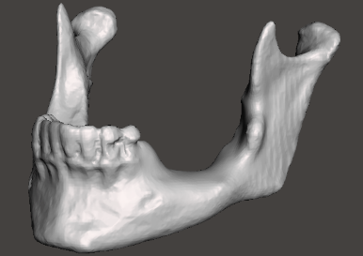
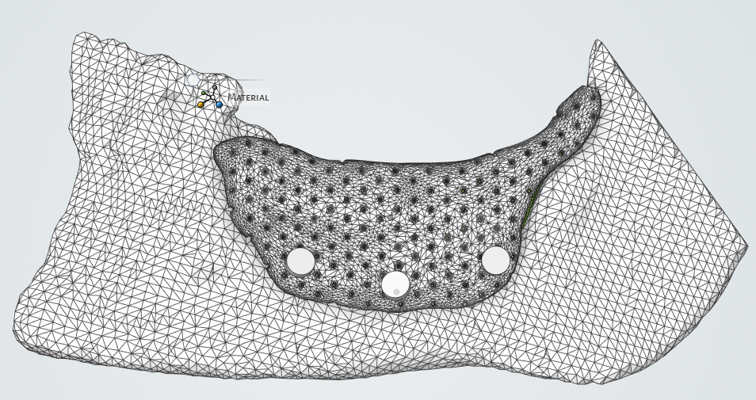
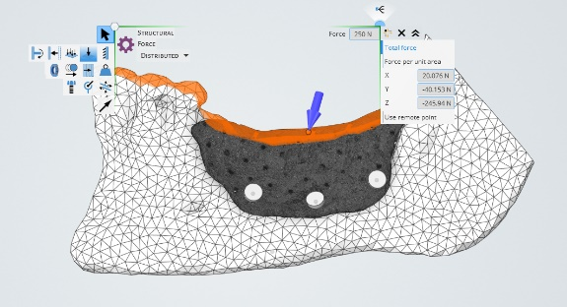
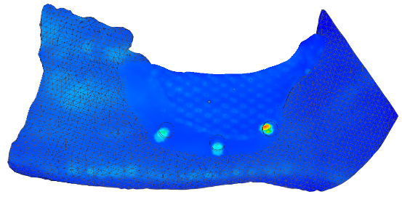
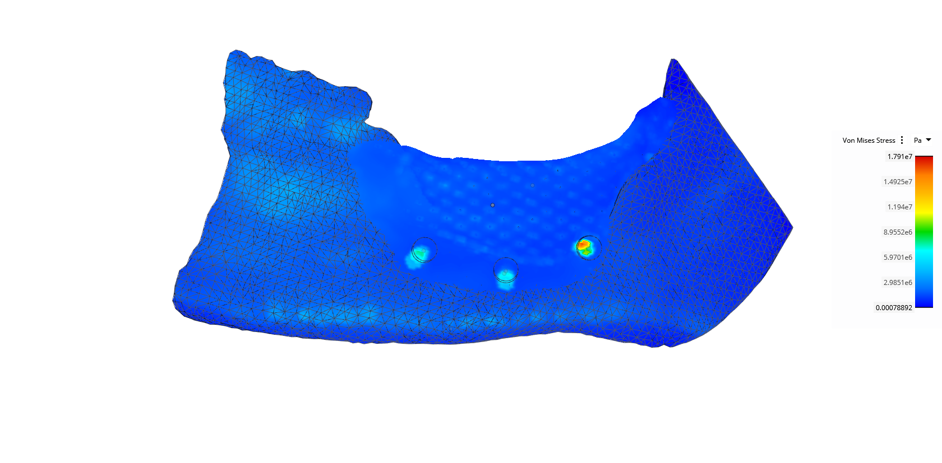
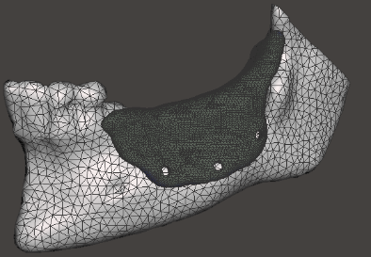
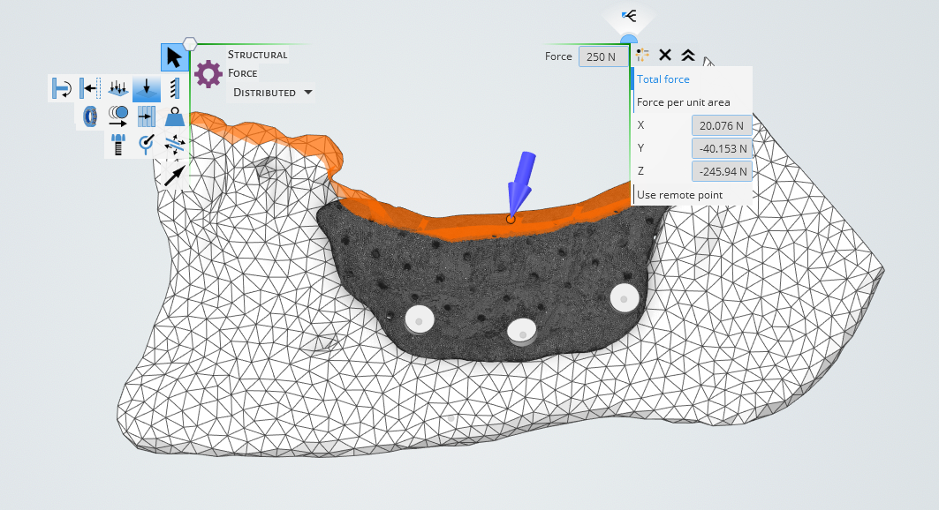
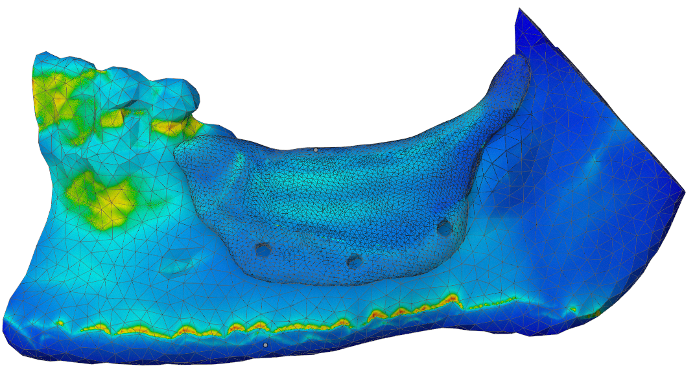
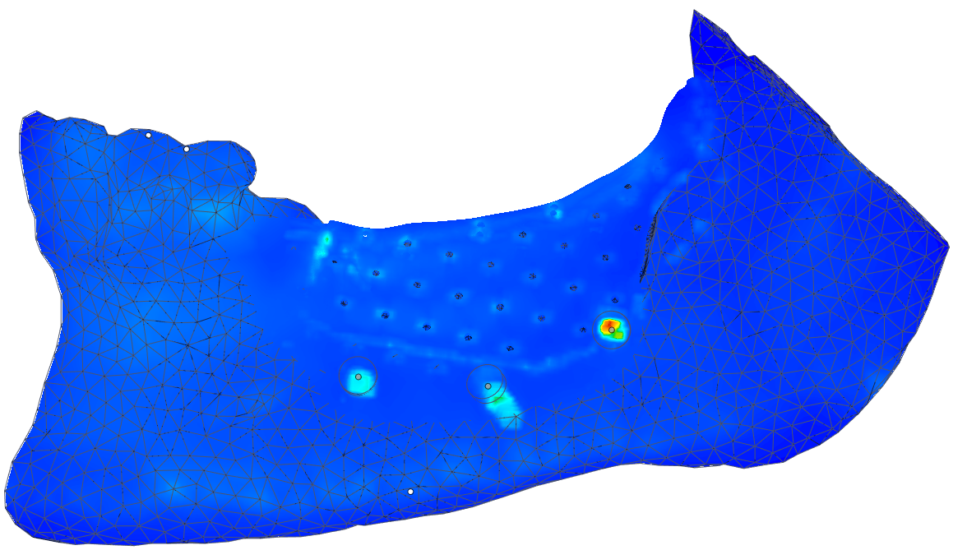
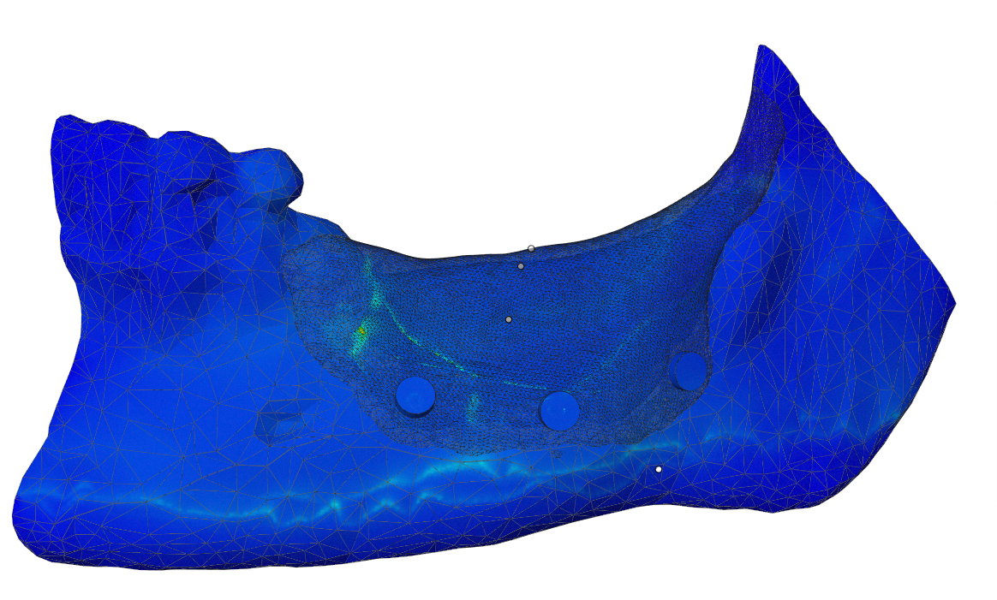
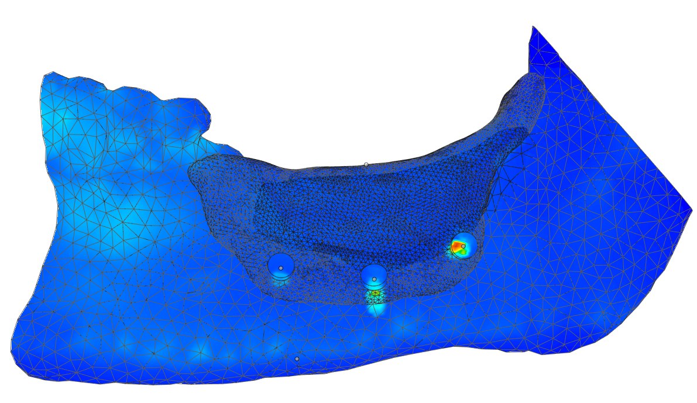
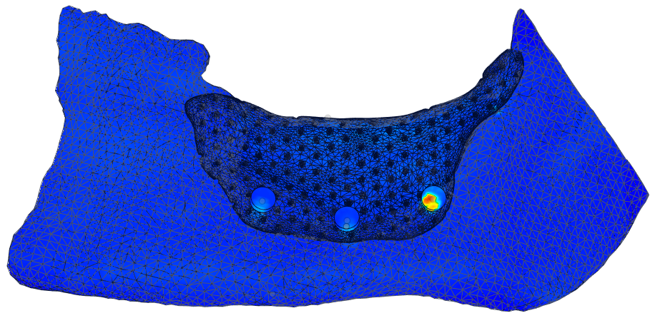
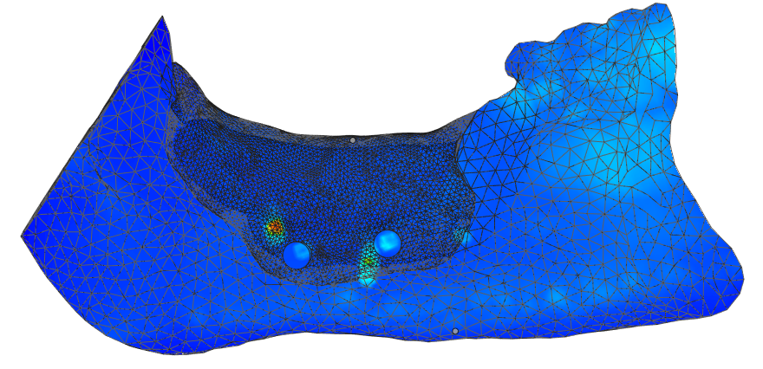
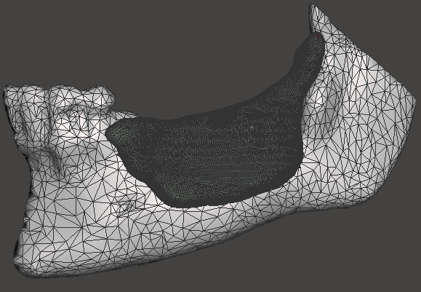
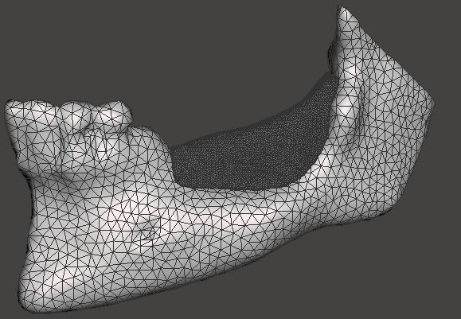
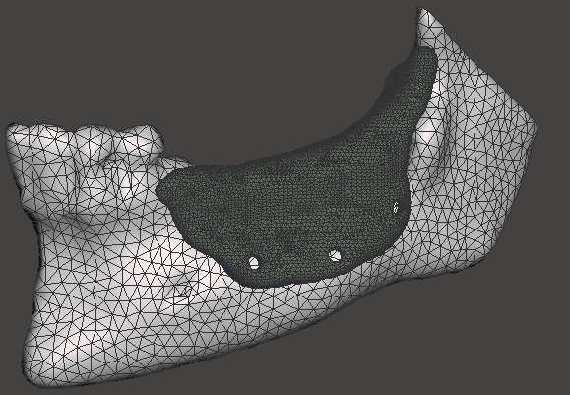

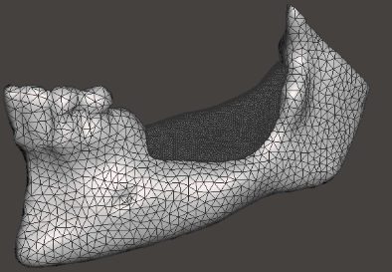
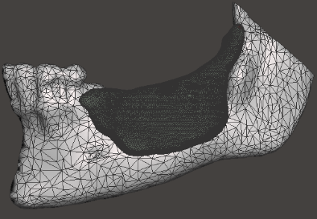
Finite Element Analysis Workflow in ANSYS
Material | Component | Young’s Modulus (MPa) | Poisson’s ratio | Tensile Yield Strength (Mpa) | References
Polycaprolactone (PCL) | Cover | 350 | 0.3145 | 2505.00 | Eshraghi²
Calcium Phosphate | Core | 191 | 0.23 | 26.00 | Kutz et al.⁷
Titanium Alloy (Ti-6Al-4V) | Pro-Fix Tenting Screws | 111240 | 0.3387 | 8457.00 | ANSYS Materials
Compact Bone | Mandible | 2000 | 0.4 | 10.95 | Talmazov⁸
Meshmixer
Final file for Ansys
Material parameters
Chewing Force
Fixation of mandible
1N screw pretension
Modeled a masticatory force of 500N, which is the average of the Male and Female maximum masticatory forces.
Finite Element Analysis Workflow
Mastication
The mandible model originated from an open source (OS) file which was then imported to Meshmixer, where the core and cover were designed. We also used Meshmixer to create a porous shell pattern and generate pre-determined screw holes.
Based on the prior knowledge that the maximum masticatory force exhibited by a healthy patient was 500N, we simulated the graft to be able to withstand said maximum in Ansys 11.0.
The materials modeled were polycapralactone (PCL) for the cover and tricalcium phosphate/ hydroxyapatite ceramic paste for the core. As well as Ti-6Al-4V screws.
The streamlined simulation allowed us to prove that it would be effective in a patient prior to even 3D printing it as well as providing us a method to continue iterating.
Forces
Screws | Porosity | Core Materials | Mastication Location
3 buccal screws | 0.5 mm | Hydrogel GelMa/ TCP | Only Teeth
3 buccal screws & 2 lingual screws | 1 mm | Calcium Phosphate | Along entire ridge
No screws | --------------- | --------------- | ---------------
Screws | Porosity | Core Materials | Defect
 |  |  | ---------------
 | --------------- | --------------- | ---------------
250N distributed downward force at a 65° angle
Fixed along the inferior edge
Bonded contacts
Healthy mastication, the maximum possible load
24N Bolt preload
Assumptions
Tricalcium phosphate/ hydroxyapatite coated in methacrylated alginate
500N distributed masticatory force
Open source large defect mandible
Polycapralactone (PCL)
Polycapralactone (PCL)
Screw holes
Notes:
A graft was designed to fit an open source mandible model with a defect. *click* The simplified loads expected on the mandible are a maximum human masticatory load of 250N distributed downward force at a 65 deg angle. *click* The mandible was fixed along the inferior edge. *click* The screws were modeled under 24N of bolt preload. *click* The graft was assumed to be bonded as well as modeling healthy maximum mastication. *click* The parameters compared were screw locations, cover porosity, core properties and whether mastication occurred on just the teeth or along the entire ridge.

Slide 5
Grant Acknowledgement
For TL1 Predoctoral and Post-Doctoral Awardees: “This project was funded with support from the Indiana Clinical and Translational Sciences Institute which is funded in part by Award Number TL1TR002531 from the National Institutes of Health, National Center for Advancing Translational Sciences, Clinical and Translational Sciences Award. The content is solely the responsibility of the authors and does not necessarily represent the official views of the National Institutes of Health.”
Notes:
I was supported by a CTSI TL1 predoctoral award.

