Slide 1
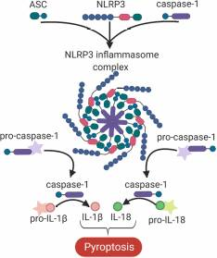
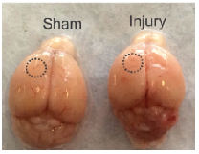
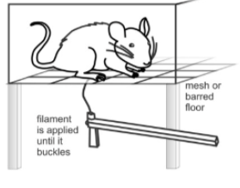
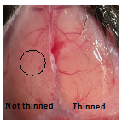
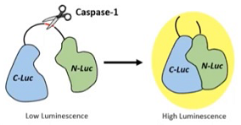
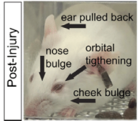
Introduction and Methods

Slide 2
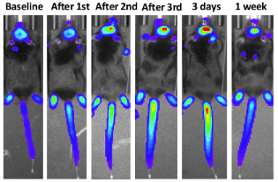
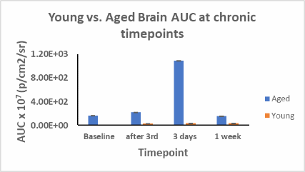
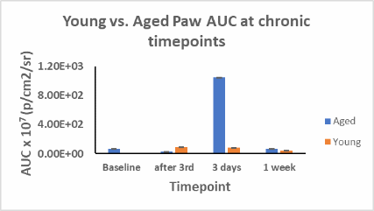
Results

Slide 3
Discussion
Relative to young animals, the aged animals exhibited a significant increase in caspase-1 activation at the 3 days after 3rd injury timepoint in both the brain and paw regions
There were no significant differences in von Frey or grimace scores between the young and aged animals at any timepoint
This study will be repeated with increased group sizes to increase predictive effect and decrease standard error
After one-month timepoint, animals will undergo immunohistochemical staining to investigate activation of caspase-1

