Slide 1
Indiana Clinical and Translational Sciences Institute
2023 Annual Meeting
Elucidating Abnormal Myeloid-Mechanical Interactions in Glioblastoma
Alice Burchett, PhD Student, University of Notre Dame
Prof. Meenal Datta, Assistant Professor, University of Notre Dame

Slide 2
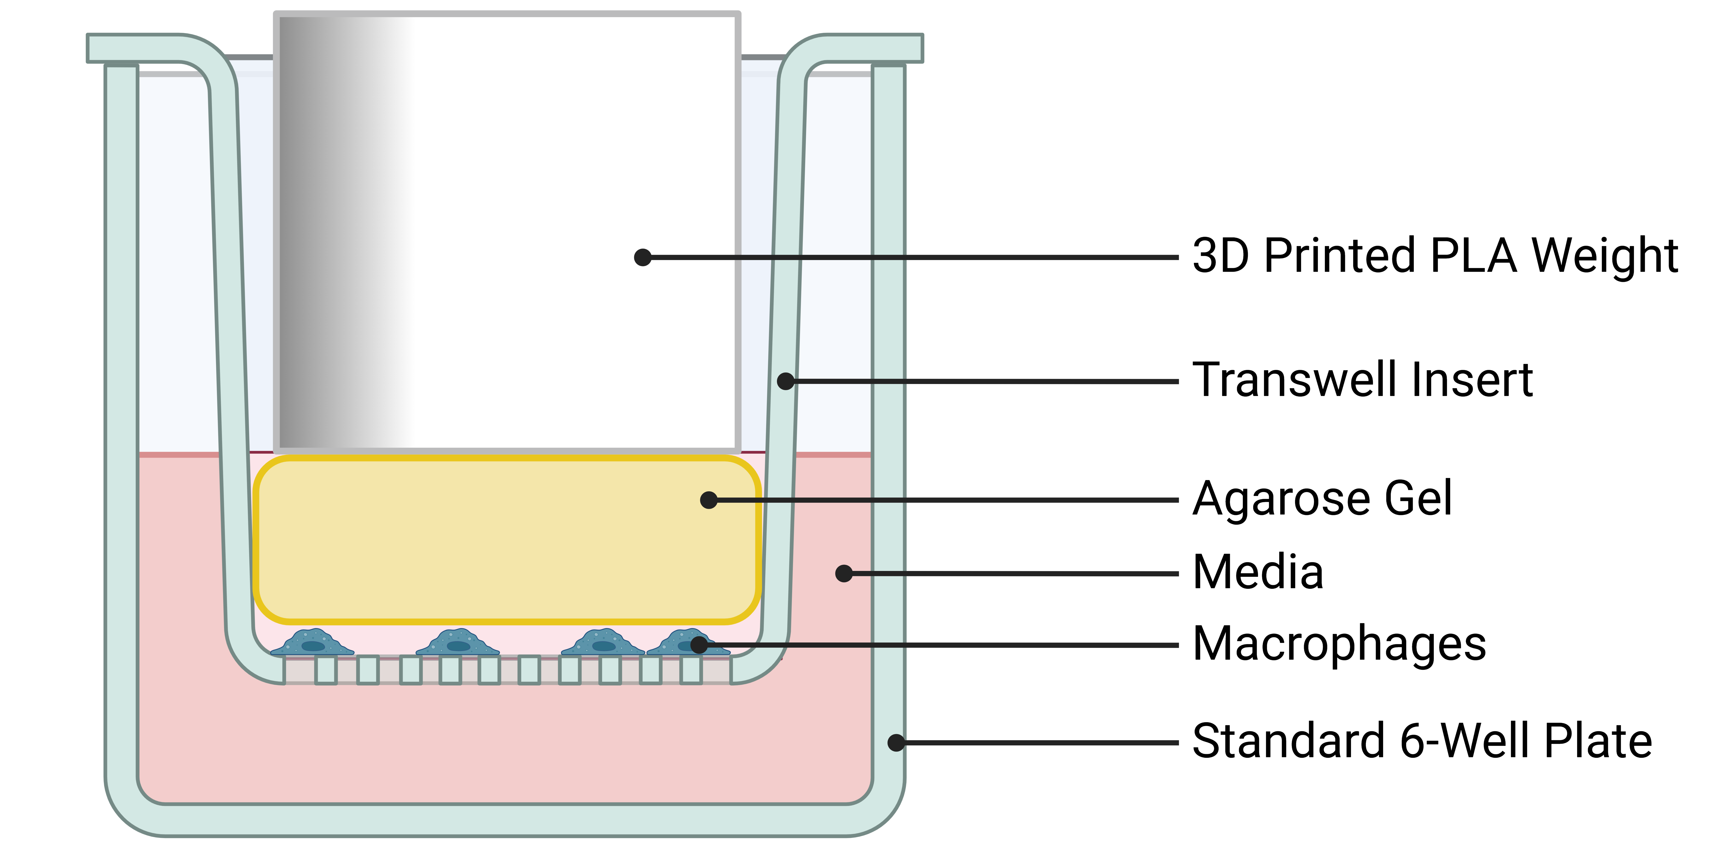
Solid Stress and Macrophage Phenotype in Glioblastoma
The innate immune response to solid stress may drive immunosuppression in glioblastoma
Myeloid cells contribute to up to 50% of tumor mass
Solid stresses (compression and tension) arise in brain tumors
~0.1-0.2 kPa of compressive stress
In vitro model mimics compressive stress in tumor
Interrogate mechanical effects independently from biological effects of tumor-induced compression
Preliminary data suggests compression alters macrophage phenotype
Gene Expression in Compressed Macrophages

Slide 3
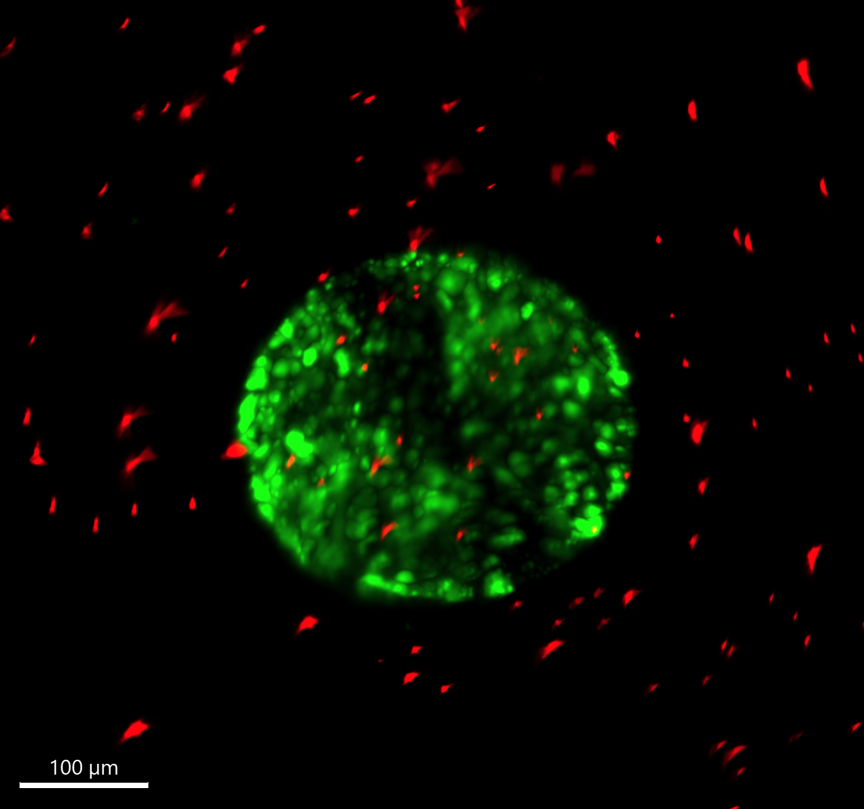
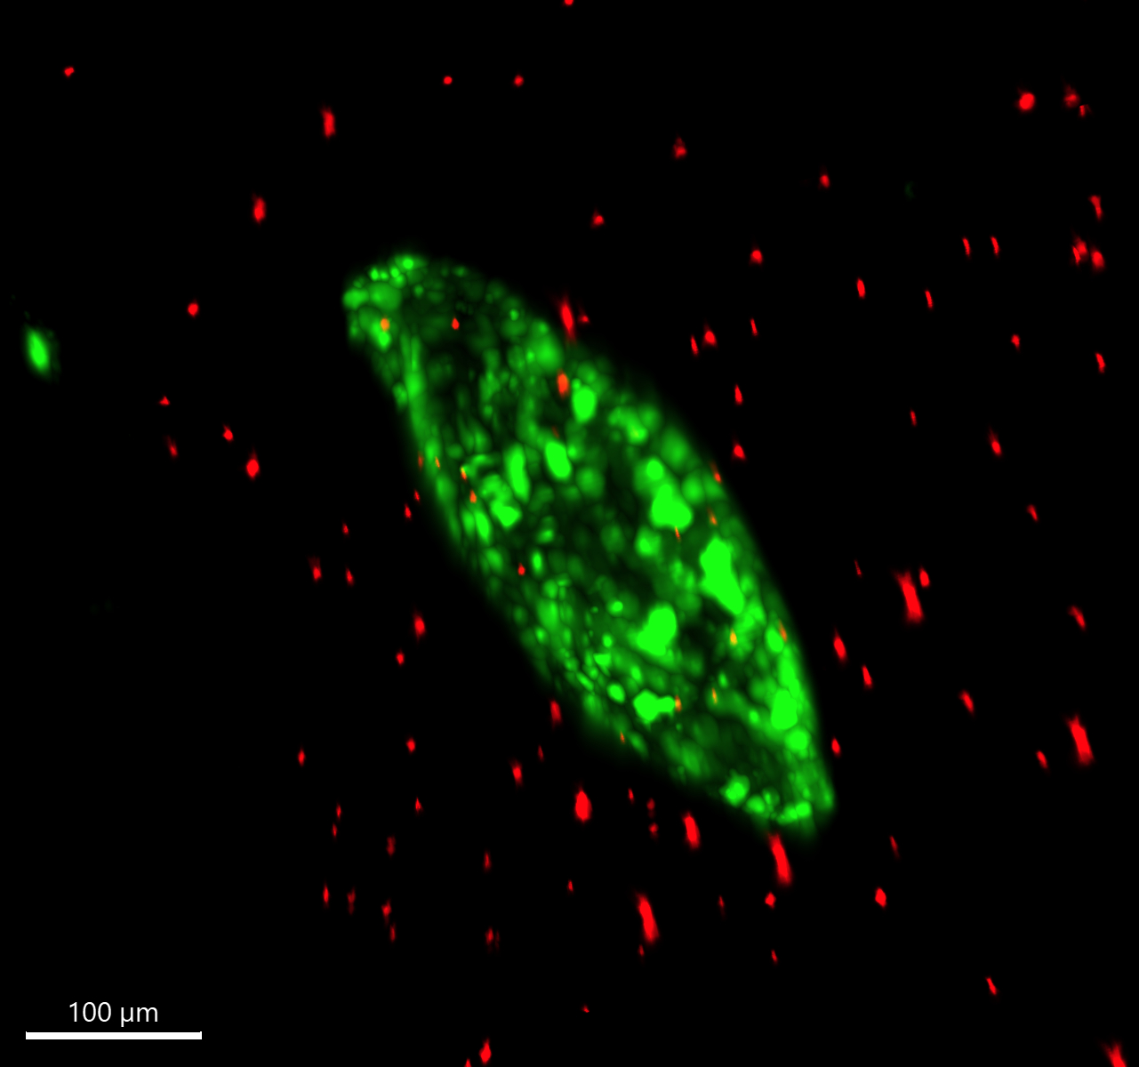
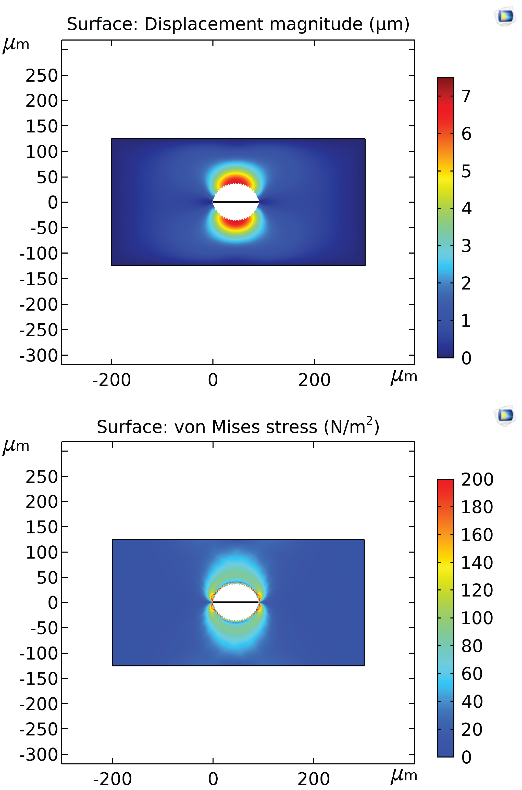
Quantification of Macrophage Contribution to Solid Stress
Agarose-embedded macrophages proliferate to form spheroids, inducing solid stress on surrounding gel
Quantify solid stress based on:
Displacement of microbeads in the gel
Mathematical modelling based on spheroid geometry
This model allows us to determine:
The relative contribution of different cell populations to solid stress
The effect of therapies on generation of solid stress

Slide 4
Significance and Future Work
Understanding and targeting the myeloid-mechanics interaction is a new and promising direction for cancer treatment
This is the first work studying the effect of solid stress on macrophages in the glioblastoma tumor microenvironment
Novel agarose-embedded culture allows us to systematically determine what cellular processes contribute to solid stress, and how they can be targeted
These models are easily tunable to other cancer types and diseases
Notes:
Emphasise that gbm is incurable, other treatments fail

Slide 5
Acknowledgements
This project was funded with support from the Indiana Clinical and Translational Sciences Institute which is funded in part by Award Number UL1TR002529 from the National Institutes of Health, National Center for Advancing Translational Sciences, Clinical and Translational Sciences Award. The content is solely the responsibility of the authors and does not necessarily represent the official views of the National Institutes of Health.
Prof. Meenal Datta
Killian Onwudiwe
Saeed Siri
Golnaz Asaadi Tehrani
R’nld Rumbach
Alice Burchett
Julian Najera
Maksym Zarodniuk
Notes:
If your project or training has been supported by the Indiana CTSI, your poster and PowerPoint presentation should include acknowledgement of the appropriate Indiana CTSI grant.
For your convenience, we have added this list of award sources to the last slide of the PowerPoint template. Please review the list of award sources and delete those that did not contribute to the conduct of the research reported in your presentation.
If your project or training was supported by other grants, please remember to acknowledge those grants as well.

