Slide 1
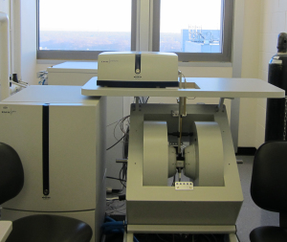
Medical Neurosciences
Undergraduate Summer Research Program
SCHOOL OF MEDICINE
STARK NEUROSCIENCES RESEARCH INSTITUTE
OVERVIEW
The Medical Neuroscience Undergraduate Summer Research (MNUSR) Program at the Indiana University School of Medicine in Indianapolis and the Stark Neurosciences Research Institute (SNRI) is an intense 9 week program designed to provide a strong foundation for developing and fostering research skills in the field of Neuroscience. There are more than 75 faculty members to serve as research mentors for the MNUSR Program at SNRI, whose interests span broadly on the biology of the nervous system with a focus on its disorders, disease, injury, and repair. Basic and translational research specialties of our faculty mentors include neuroimmunology, pain and sensor systems, spinal cord and brain injury, as well as a number of developmental, affective, mood, movement, neurodegenerative and addictive disorders.
THE PROGRAM
Summer 2019 – dates and additional information to follow
Neuroscience Research: Conduct laboratory research in a SNRI research mentor’s laboratory.
Weekly Course: Receive training in biosafety, research ethics, and animal models in the course Laboratory Research Foundations.
Poster Presentation: Develop presentation and organizational skills
Stipend: $3000
Application period opens November 9, 2018 Deadline is January 4, 2019
Apply at: https://starkmedneuro.org Questions may be directed to: stark1@iupui.edu

