Slide 1
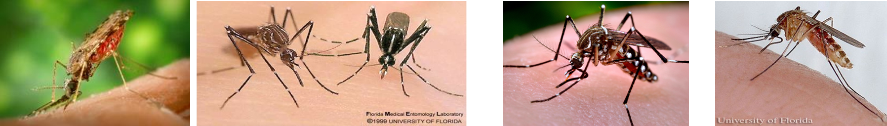


Yeast RNAi-based Attractive Targeted Sugar Baits (ATSBs) for Mosquito Control
Teresia Njoroge, PhD
Postdoctoral Research Associate
Department of Medical and Molecular Genetics,
Indiana University School of Medicine-South Bend and
Eck Institute for Global Health, Notre Dame
I-CTSI 2023 Annual Meeting

Slide 2
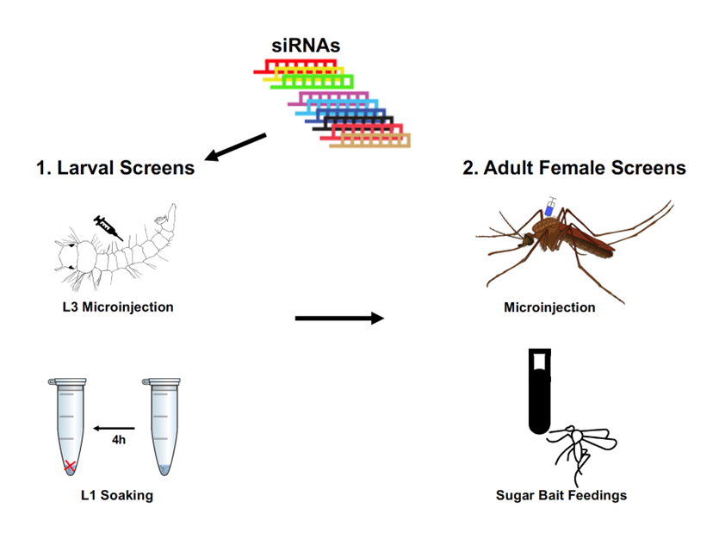
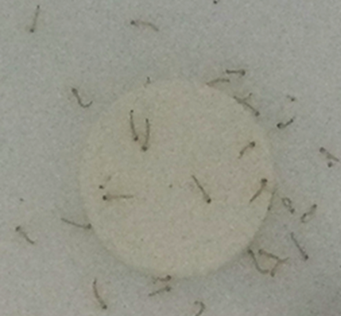
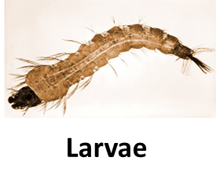
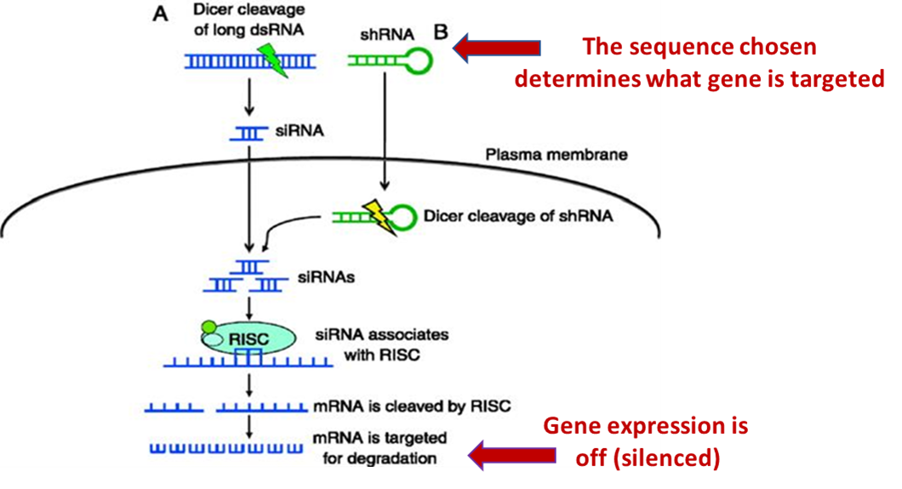
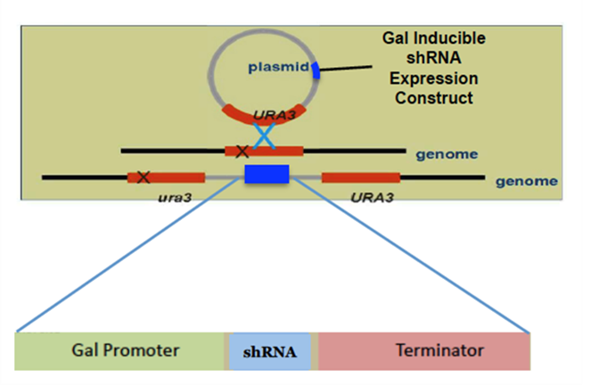
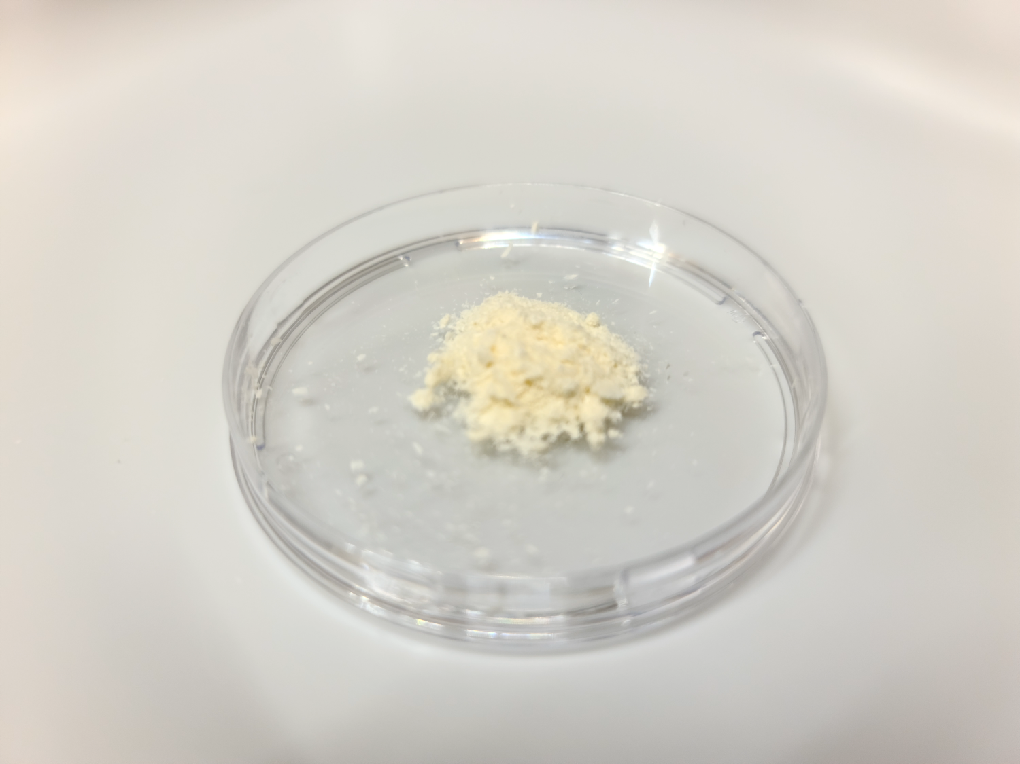

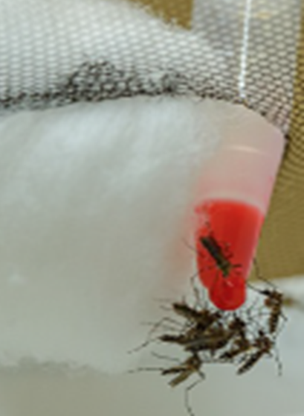
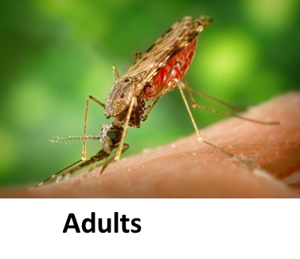

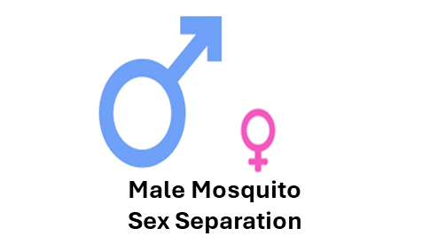
Development of Yeast RNA interference (RNAi) pesticides for mosquito control
RNA interference (RNAi) mechanism
RNAi Screens
Current mosquito control methods are insufficient
  Due to widespread insecticide resistance
  Public health & environmental safety concerns regarding chemical insecticides
Urgent need to discover new effective & environmentally safe interventions
Focus on Yeast RNA interference (RNAi) pesticides
RNAi yeast
Cloned in Saccharomyces cerevisiae
(baker’s yeast)

Slide 3
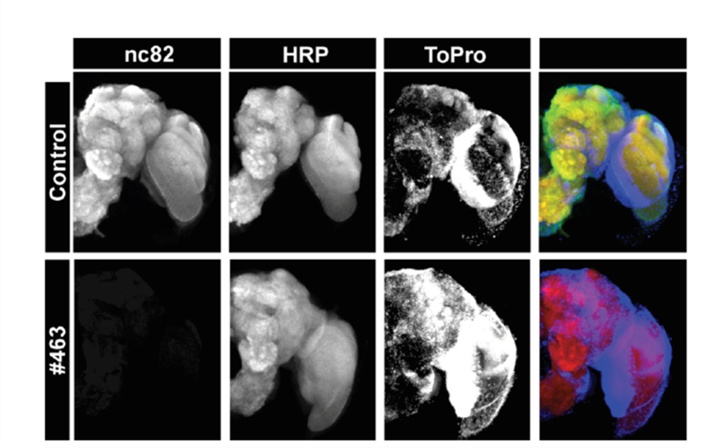
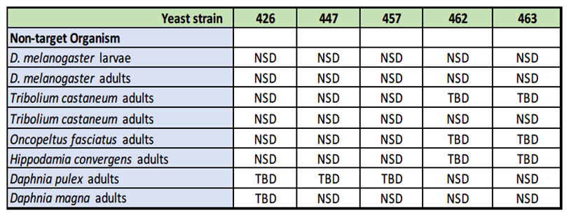
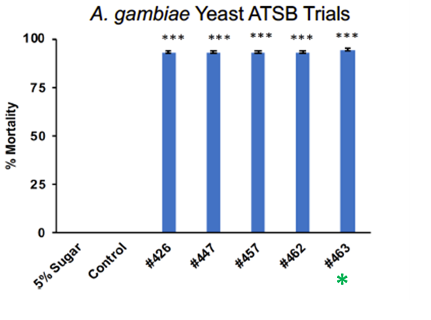
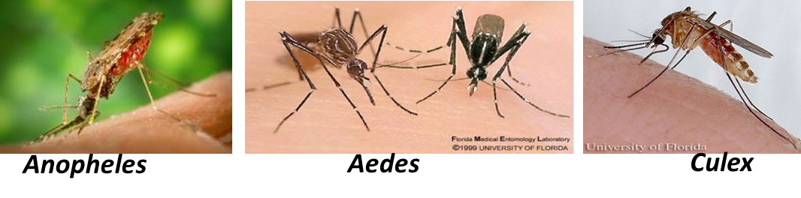
Yeast RNAi pesticides kill multiple disease vector mosquitoes
Sh.463 RNAi yeast pesticide
Sh.463 Neural Mode of Action
A.gambiae Shaker transcripts
*RNAi yeast does not kill non-target arthropods
Silencing the Shaker gene results in loss of neural activity
Mysore et al., 2020, 2021a,b, in prep

Slide 4
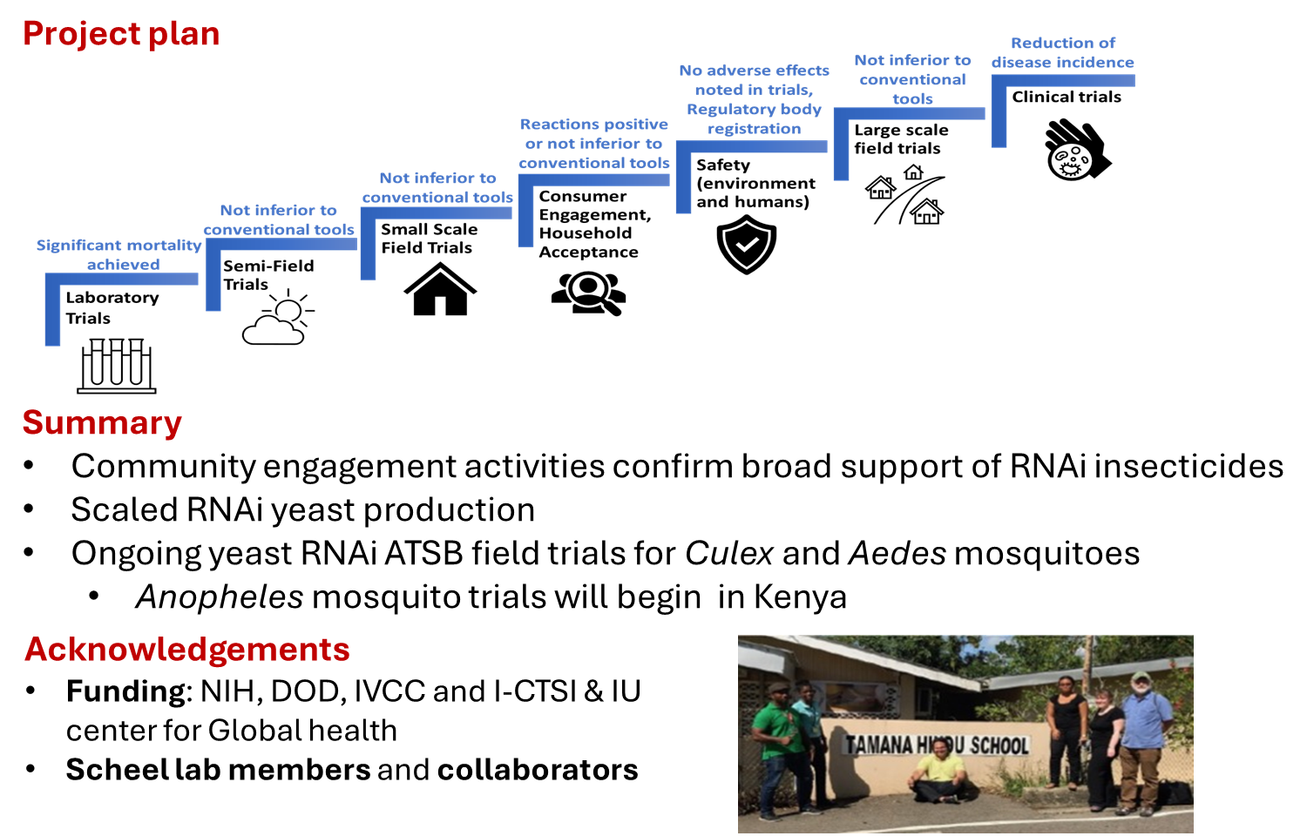
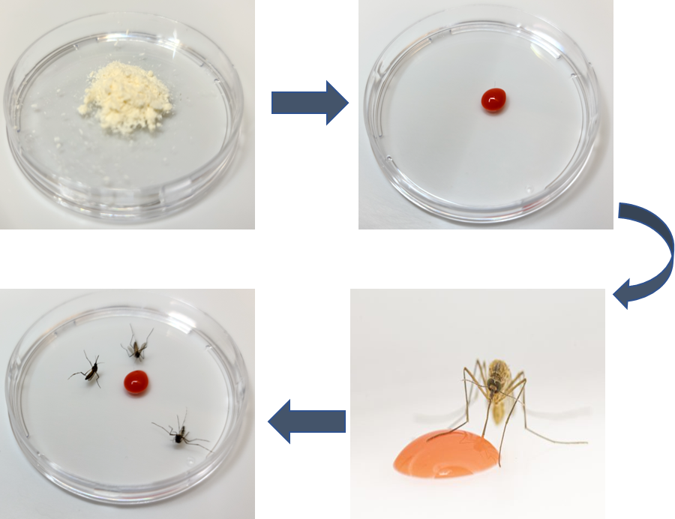
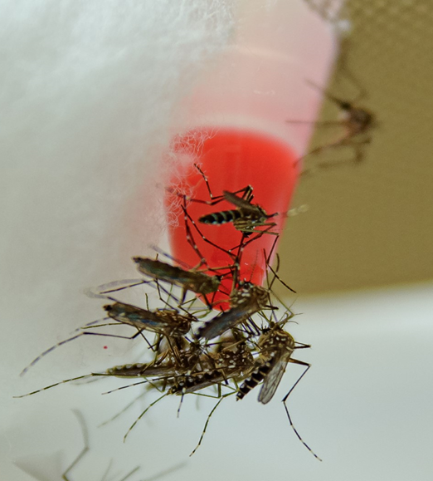
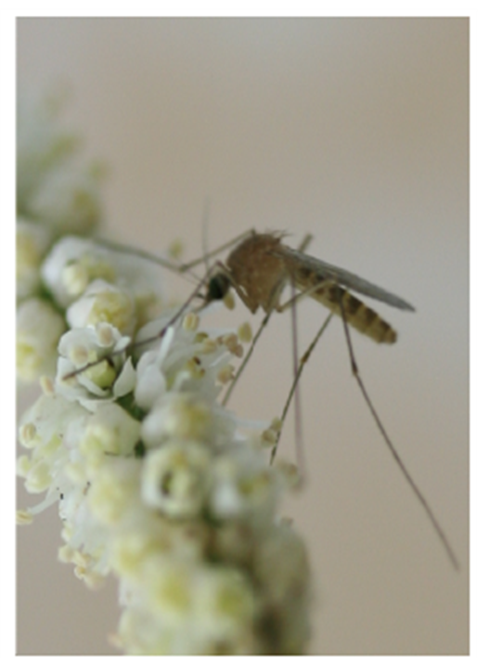
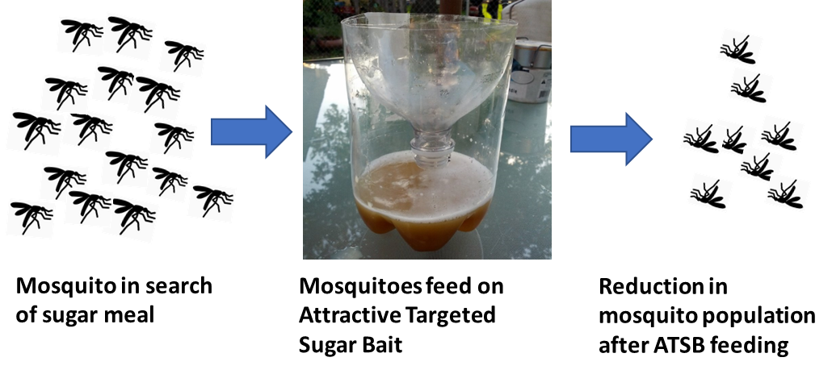
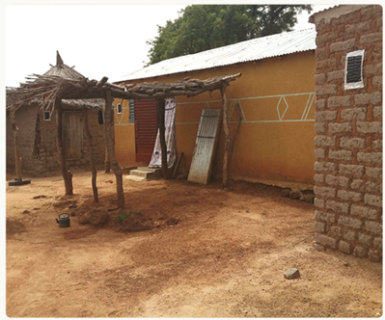
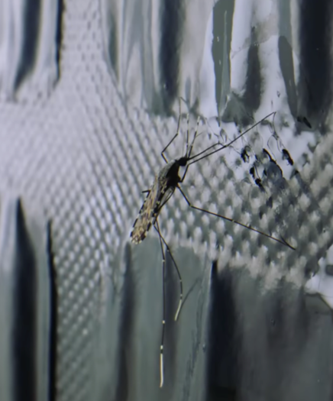
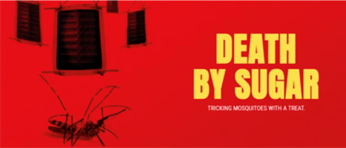

Attractive targeted Sugar Baits (ATSBs): A New Mosquito Control Paradigm
Yeast RNAi ATSBs
Attractive targeted Sugar Baits (ATSBs)
Mosquitoes feeding on yeast RNAi ATSB in the lab
Mysore et al., 2020
Yeast RNAi ATSBs deployment in the field
https://endmalaria.org/sites/default/files/7_Gunter%20Mueller.pdf
https://www.ivcc.com/research-development/atsb/
https://www.ivcc.com/mosquito-factory-new-outdoor-biting-invention-tool/
Notes:
ATSBs exploit the sugar feeding behavior of adult mosquitoes by attracting them to a source containing an insecticidal ingredient

